Slide 1
Practice Plus Agenda July 2020
12.45
Welcome , introduction and reflections following June Webinar
STOP, THINK, RE-FOCUS
Non-Clinical Resource: UK Survey on Pharmacy services in primary care
Steve Williams
12.55
Why and how we can all best use the Polypharmacy Prescribing Comparators to aid Structured Medication Review (SMR) patient selection
(including Q&A for 10 mins)
Clare Howard
1.25
Demand and capacity to meet the NHS Direct Enhanced Service (DES) specification for SMRs
How in time you could link SMRs with long term condition QOF reviews
Steve Williams
1.40
Plans for future
PrescQIPP Webinar Patient centred SMRs - Prof Nina Barnett 27th July
Salford medication safety dashboard- Prof Darren Ashcroft and Asthma focus Aug 19th
“Slack” platform as the online chat forum
Share point access for members
Steve Williams

Slide 2
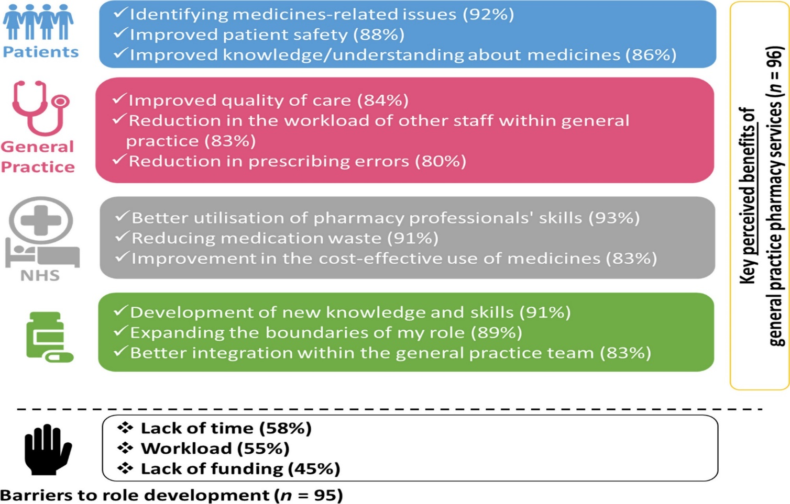
Pharmacy services and role development in UK general practice: a cross‐sectional survey
International Journal of Pharmacy Practice, First published: 05 July 2020, DOI: (10.1111/ijpp.12653)
Notes:
Key perceived benefits of general practice pharmacy services and barriers to role development or working in general practice.
IF THIS IMAGE HAS BEEN PROVIDED BY OR IS OWNED BY A THIRD PARTY, AS INDICATED IN THE CAPTION LINE, THEN FURTHER PERMISSION MAY BE NEEDED BEFORE ANY FURTHER USE. PLEASE CONTACT WILEY'S PERMISSIONS DEPARTMENT ON PERMISSIONS@WILEY.COM OR USE THE RIGHTSLINK SERVICE BY CLICKING ON THE 'REQUEST PERMISSIONS' LINK ACCOMPANYING THIS ARTICLE. WILEY OR AUTHOR OWNED IMAGES MAY BE USED FOR NON-COMMERCIAL PURPOSES, SUBJECT TO PROPER CITATION OF THE ARTICLE, AUTHOR, AND PUBLISHER.

Slide 3
Polypharmacy Prescribing Comparators
Transforming the way GPs, PCNs and CCGs use data to find people at risk from harm from polypharmacy and reduce that harm.
Medicines.Optimisation@wessexahsn.net
September 2019
Clare Howard FFRPS FRPharmS
Notes:
Clare Howard, Clinical Lead Medicines Optimisation at Wessex Academic Health Science Network (AHSN). Clare was previously Deputy Chief Pharmaceutical Officer for NHSE and is now a Health Foundation Q member who leads England wide Medicines Optimisation Quality Improvement projects for AHSNs, including the work on National Polypharmacy Prescribing Comparators (EPACT2) which won the prestigious HSJ Patient Safety Award in 2019. She will talk to us about why and how we can all best use the comparators to aid structured medication Review (SMR) patient selection.

Slide 4
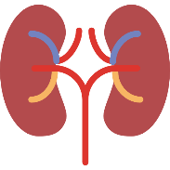
What about patients?
Comparing data from before we published the tool to June 2019 we can show…
58,300 fewer patients prescribed two or more unique medicines likely to cause kidney injury (DAMN medicines)
And 25,900 fewer patients prescribed a NSAID and one or more other unique medicines likely to cause kidney injury
7,500 fewer patients with an anticholinergic burden score of 6 or more aged 65 and over and
4,800 fewer patients with an anticholinergic burden score of 6 or more
700 fewer patients prescribed two or more anticoagulants and antiplatelet medicines
9,400 fewer patients prescribed 10 or more unique medicines
Percentage of patients medicines, 10 or more unique medicines,
Percentage of older patients prescribed medicines likely to cause Acute Kidney Injury (DAMN Drugs)
Percentage of patients with an anticholinergic burden score of 6 or greater,
9 or greater,
12 or greater
Percentage of patients prescribed multiple anticoagulant regimes
Notes:
It is possible to estimate the reduction in the number of patients receiving the relevant combinations of medications for some comparators
This involves calculating the difference between the actual number of patients for a comparator in June 2019 and the number that would have been expected had the actual number in June 2017 changed by the same proportion as the denominator by June 2019
By June 2019 there were around 58,300 fewer patients receiving two or more DAMN medicines than would have been expected if their numbers had decreased in line with the number of patients receiving one or more DAMN medicines between June 2017 and June 2019
NOTE: The numbers shown the table below for the different comparators should not be added together into a total as some patients could be included in more than one comparator

Slide 5
Poole Bay & Bournemouth PCN SMR DES 2020/21 Aims
80% Proactive (Epact 2 ) 352/440 sessions a year
(176 /220 Oct-Apr)
Primary focus: All 8+ meds
Secondary focus: NSAID /DAMN/ ACB 6+
20% Reactive (Clinician referral) 88/440 sessions a year
(44 /220 Oct-Apr)

Slide 6
Pharmacist Sessions needed to perform SMRs
Based on 30min / SMR Based on 60 mins / SMR including pre and post follow up 15 min appt
Practice | 15+ meds | 10+ meds | 8+ meds
WMC | 8.5 hrs 17 hrs | 118 hrs 236 hrs | 292 hrs 584 hrs
Denmark Rd | 11.5 hrs 23 hrs | 79 hrs 158 hrs | 151 hrs 302 hrs
Leybourne | 3 hrs 6 hrs | 28.5 hrs 57 hrs | 73 hrs 146 hrs
Winton | 4 hours 8 hrs | 41 hrs 82 hrs | 85.5 hrs 171 hrs
PCN Total sessions (3 hrs each) | 9 sessions 18 sessions | 89 sessions 178 sessions | 201 sessions 402 sessions

Slide 7
Linking SMR with Long Term Condition QOF Reviews for experienced Clinical Pharmacists
Br J Gen Pract 2018; 68 (suppl 1)
https://doi.org/10.3399/bjgp18X697097

