Slide 1
Practice Plus Webinar 16th December 2020
Steve Williams
Lead Clinical Pharmacist Prescqipp Practice Plus

Slide 2
Agenda
Time | Title | Presenter
12.45 | Welcome , introduction and reflections STOP, THINK, RE-FOCUS | Steve Williams
12.50 | De-prescribing education in County Durham CCG – A collaborative approach (including Q&A for 10 mins) | Rachel Berry, Medicines Optimisation Pharmacist County Durham CCG
1.10 | Dealing with patients suffering with stress, anxiety, and depression in primary care (including Q&A for 10 mins) | Professor Stephen Bazire, MBE, Honorary Professor, School of Pharmacy University of East Anglia, author of the Psychotropic Drug Directory
1.40 | Future PrescQIPP Webinars | Steve Williams

Slide 3
De-prescribing Education in County Durham; A Collaborative Approach
Rachel Berry – r.berry1@nhs.net
Medicines Optimisation Pharmacist
County Durham CCG

Slide 4
County Durham & Darlington
Local Pharmaceutical
Committee
GP Practice Representation

Slide 5
“One of my patients was complaining of feeling over sedated. I felt confident enough after the webinar to wean them off trazodone over 2 months. The patient said 'I am delighted with myself I feel so much better!'
GP Practice Pharmacist, Falls webinar
“This has reinforced my current practice, but I have more confidence to de-prescribe more with my elderly patients”
Nurse prescriber, CVD webinar
“After the webinar I changed my practice to add pain medication review to consultations routinely. This has led to a patient on high dose opiates successfully reducing to lower doses”
GP, Pain webinar

Slide 6
Stephen Bazire Honorary Prof. School of Pharmacy, UEA, Norwich Director, Mistura Enterprise and Mistura Informatics Trustee, Norwich and Central Norfolk Mind Former Chief and Consultant Pharmacist, Norfolk and Suffolk NHS Foundation Trust
Physical health vs mental health
Notes:
6
Meds Optimisation means everything and nothing - can cover everything from drug choice, prescribing, supply, monitoring so only going to concentrate on a handful of ideas
Understanding antipsychotics
Starting early and with the optimum
Getting duration right for optimum results
Keeping people well by approaching LAIs in the right way
Getting the doses right
Supporting people and getting them involved
Using resources wisely

Slide 7
“A brain that can’t cry
makes the other organs weep”

Slide 8
Practical advice
Ask about other symptoms and general well-being
If a mental health problem is there, it needs treating
Regardless of any precipitating reason
If you suspect, recommend person speaks to GP about symptoms
Natural concern about what you might uncover e.g. suicidal ideation
“Do you have any thoughts of harming yourself?”
Asking does not make it more likely
If yes, refer straight away

Slide 9
Key points about antidepressants
Antidepressants definitely work
There can be a placebo effect of around 30%
Antidepressants have an additional 30% effect over and above placebo
Starting:
Start slowly - SSRIs cause nausea and anxiety in some
Start with lower dose for a few days
e.g. citalopram 10mg, sertraline 25mg, fluoxetine 10mg; but not mirtazapine
Advise to take serotonergic antidepressants in the morning, not at night
Boosting serotonin at night disrupts sleep architecture
Antidepressants do not cause suicide
Dozens of huge studies show suicide rates are inversely proportional to antidepressant use (DDDs)
Some initial akathisia in some people can trigger ideas of self-harm
Onset of action
If an antidepressant is going to work it starts within 1-2 weeks, not 4 weeks…
Notes:
NICE Depression Guidelines Draft September 2017
An antidepressant “takes typically 2-4 weeks to begin to start to feel better”

Slide 10
Duration of antidepressant treatment
40% of people may relapse after an index depressive episode within 2 years, and 60% within 5 years
First episode:
Six months after recovery at same dose minimises risk of relapse
(n=839, RCT, one-year, Reimherr et al, Am J Psych 1998:155;1247-53
Second episode:
1-2 years
Third or subsequent episode:
3-5 years or longer
(Frank and Kupfer, Arch Gen Psych 1990 and 1992)
The NNT for prevention of relapse of depression by antidepressants is 4.3
(s=31, n=4410, Geddes et al, Lancet 2003;361:653-61)
Just because someone isn't depressed
does not mean they don't need an antidepressant
Notes:
NNT of 4.3
Or n
Just because seed a good reason to come off
Double negatives are a complete no-no. Three double negatives in a sentence – it’s a no-no-no
Just because someone isn't depressed does not mean they don't need an antidepressant - the antidepressant could be the reason they’re not depressed

Slide 11
© www.choiceandmedication.org/<code> 12/2020

Slide 12
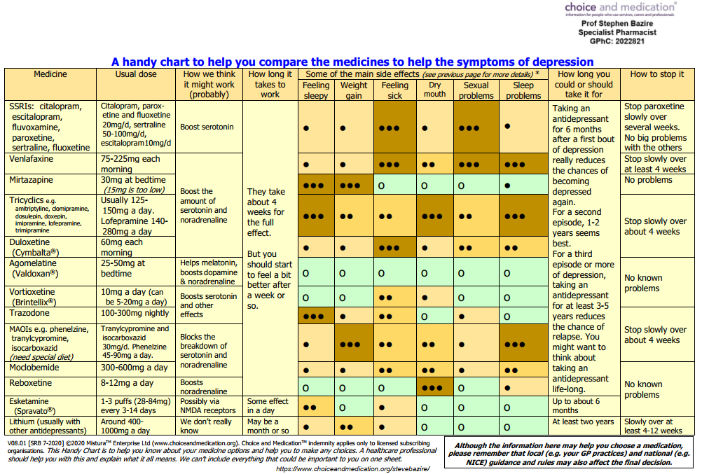
SPRAVATO® Summary of Product Characteristics. December 2019
© www.choiceandmedication.org/<code> 12/2020

