Slide 1
Practice Plus Webinar June 23rd 2021
Steve Williams
Lead Clinical Pharmacist PrescQIPP Practice Plus

Slide 2
Agenda
Time | Title | Presenter
12.45 | Welcome , introduction and reflections STOP, THINK, RE-FOCUS | Steve Williams
12.50 | Acute Coronary Syndromes - new NICE guidance (including Q&A for 10 mins) | Helen Williams Consultant Pharmacist for CVD Disease Southwark CCG National Specialty Adviser for Cardiovascular Disease Prevention at NHS England and NHS Improvement
1.20 | Improving Medicines and Polypharmacy Appropriateness Clinical Tool (IMPACT) (including Q&A for 10 mins) | Sajida Khatri Director of Medicines Optimisation PrescQIPP
1.40 | Future PrescQIPP Webinars | Steve Williams

Slide 3
Optimising Outcomes in Acute Coronary Syndromes
Helen Williams
Consultant Pharmacist for CVD, SEL CCG
National Specialty Adviser for CVD Prevention, NHSE&I

Slide 4
Drug Therapy
Prevent clot formation
Reduce cardiac workload and improve blood supply
Prevent further coronary events
Manage symptoms and improve prognosis
All patients who have had an ACS should be offered treatment with the following drugs:
Aspirin and additional anti-platelet therapy (clopidogrel / prasugrel / ticagrelor) for at least one year
ACE inhibitor
Beta-blocker for at least 12 months
Statin
https://www.nice.org.uk/guidance/ng185

Slide 6
Antiplatelet therapy challenges in primary care
Bleeding
Rashes (clopidogrel)
Transient breathlessness (ticagrelor)
PREMATURE DISCONTINUATION
Adverse effects
Surgery
Non-adherence

Slide 7
Summary: Antiplatelet Therapies - ACS
Aspirin 75mg od + clopidogrel 300mg loading dose then 75mg od for one year if high bleeding risk
OR
Aspirin 75mg od + prasugrel 60mg loading dose then 10mg od for one year if ACS with PCI (preferred if STEMI)
OR
Aspirin 75mg od + ticagrelor 180mg loading dose then 90mg bd for one year if ACS with PCI or for medical management

Slide 8
Antiplatelets… after 12 months
Stop and revert to monotherapy
OR
Switch to aspirin plus ticagrelor 60mg bd for a further 3 years (if meet DRAMA criteria)
OR
Switch to Aspirin plus rivaroxaban 2.5mg bd (if meet NICE criteria)

Slide 9
Aspirin plus ticagrelor 60mg bd
DRAMA criteria : from PEGASUS TIMI-54
History of a spontaneous MI 1–3 years prior to enrolment and one additional high-risk feature
Diabetes mellitus requiring medication
Chronic, non-end-stage Renal dysfunction (CrCl <60 mL/min)
Age ≥65 years old
Angiographic evidence of Multivessel CAD
A second prior spontaneous MI
Brilique SPC https://www.medicines.org.uk/emc/product/7606/smpc#gref

Slide 10
Aspirin plus low dose rivaroxaban
For people with coronary artery disease, high risk of ischaemic events is defined as:
aged 65 or over, or
atherosclerosis in at least 2 vascular territories (such as coronary, cerebrovascular, or peripheral arteries), or
2 or more of the following risk factors:
current smoking
Diabetes
kidney dysfunction with an estimated glomerular filtration rate (eGFR) of less than 60 ml/min (note that rivaroxaban is contraindicated if the eGFR is less than 15 ml/min)
heart failure
previous non-lacunar ischaemic stroke
Symptomatic PAD
https://www.nice.org.uk/guidance/ta607

Slide 11
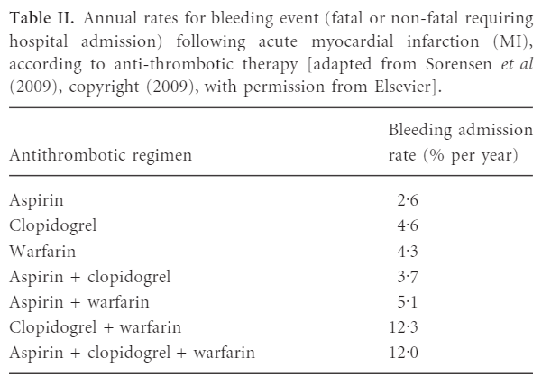
https://onlinelibrary.wiley.com/doi/epdf/10.1111/j.1365-2141.2011.08753.x

Slide 13
ACEi
Improved outcome post-ACS with or without HF
With HF: AIRE, GISSI-3
Without HF: HOPE, EUROPA
Use ARB if ACEi not tolerated
Titrate to maximum tolerated or target dose (e.g ramipril 5mg bd)]
Complete dose titration within 4-6 weeks of discharge
Monitor renal function, electrolytes and BP within 1-2 weeks of each dose change
Adverse effect: symptomatic hypotension

Slide 14
Beta-blockers
Reduce mortality by up to 45% post-MI
control heart rate
improve blood supply
reduce cardiac workload, therefore reducing oxygen requirements
Also useful for preventing episodes of angina
Titrate to maximum tolerated or target dose (e.g. bisoprolol 10mg daily)
Continue for at least 12 months. Continue indefinitely if HFrEF
Side effects:
Symptomatic hypotension, bradycardia, lethargy / fatigue
Circulation 1983 Jun;67(6 Pt 2):I49-53; JAMA.1982;247(12):1707-1714

Slide 15
Issues with statins
Use of low / moderate intensity statins
Statin hesitancy
Impact of the media
Statin intolerance
Adherence and persistence

Slide 16
Difficulties Achieving Global CV risk Reduction in ACS
Failure to recognise global risk
Lack of understanding of the interventions
Adherence
Patients don’t understand the difference between drugs to control symptoms and drugs to reduce risk
Adverse effects
Complex regimens
Failure to dose titrate
Short length of hospital stay
Lack of incentives for primary care
Inability to achieve optimal doses therefore may not deliver optimal outcomes

Slide 17
Improving Medicines and Polypharmacy Appropriateness Clinical Tool (IMPACT)
Saj Khatri
Director of Medicines Optimisation
PrescQIPP

Slide 18
Kathleen is 84 years old and lives in a sheltered housing complex
In the last few months she’s had several falls which have knocked her confidence
She’s also finding the burden of the number of medicines that she’s taking increasingly problematic

Slide 19
Heart failure – for 4 years
Hypertension – for 14 years
Type 2 diabetes – for 12 years
Osteoporosis – for 7 years
Night leg cramps – for 6 years
Recent falls

Slide 20
Simvastatin 40mg nocte
Furosemide 40mg daily
Alendronate 70mg weekly
Aspirin 75mg daily
Omeprazole 20mg daily
Quinine 300mg nocte
Adcal D3® 2 daily
Metformin 500mg bd
Gliclazide 80mg bd
Bisoprolol 2.5mg daily
Ramipril 1.25mg daily

Slide 21
IMPACT

Slide 23
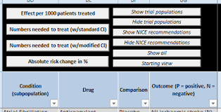
NG56 Database of Treatment Effects can be used to inform discussions between patient and clinician when considering the benefits and harms of taking long term medication
For example, we can see from clinical trials that, on average, the effect of statins on all-cause mortality in primary prevention is “5 fewer deaths per 1000 patients treated for 3.2 years”

Slide 24
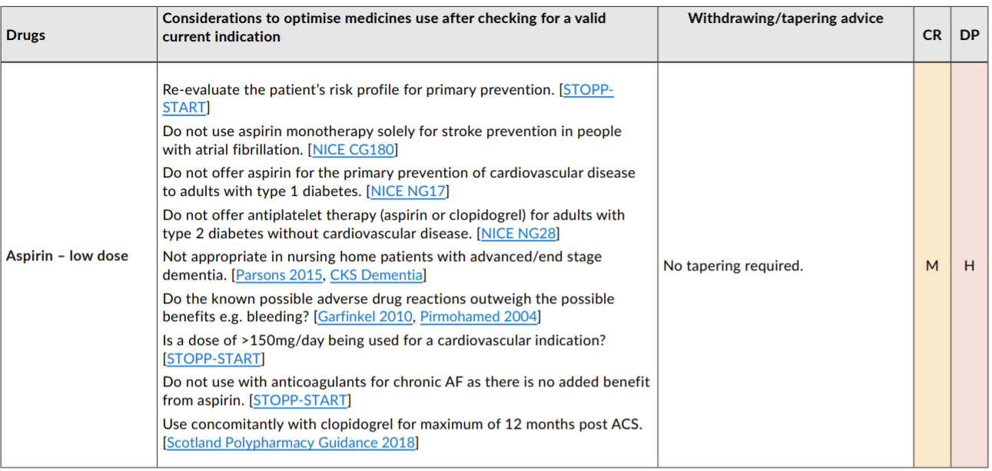
IMPACT

Slide 25
IMPACT

Slide 26
Kathleen has been taking quinine for over five years
She doesn’t really know whether it’s working or not anymore and she’s happy to have a trial off treatment

Slide 27
A PDA accompanies the NICE guideline.
You talk through the PDA with Kathleen and explain the risks and benefits and the drug choices.

Slide 30
Metformin 500mg bd
Bisoprolol 5mg od
Furosemide 40mg od
Edoxaban 30mg od
Omeprazole 20mg od
Ramipril 10mg od
She is taking six medicines instead of eleven and their outcomes are being optimised.

Slide 31
Future Practice Practice Plus Webinars
Date | Key themes | Guest Presenters
July 14th 2021 | Mental Health update : STOMP agenda re SMRs Practice Plus membership: Focus on Best Practice / SMR case | Dave Gerrard Health Improvement Pharmacy lead Learning Disability and Autism NHS England
Aug 18th 2021 | NICE Shared Decision Making | Jonathan Underhill Consultant clinical adviser for NICE
Sept 22nd 2021 | NHSBSA Polypharmacy – New Indicators for 2021 | Clare Howard Medicines Optimisation Lead Wessex AHSN
TBC | DH Over prescribing- Lelly Oboh Medication Safety NHSE/I Social Prescribers First Contact Physiotherapists re MSK / Pain

