Slide 1
Practice Plus Webinar 9th February 2022
Steve Williams
Lead Clinical Pharmacist PrescQIPP Practice Plus

Slide 2
Using Antibiotic data to influence change within a PCN
Steve Williams
Lead Clinical Pharmacist PrescQIPP Practice Plus

Slide 3
The COM-B system: Behaviour occurs as an interaction between three necessary conditions
Psychological AND Physical ability to enact the behavior
Knowledge, Memory attention decision making, physical and social skills
Reflective AND Automatic mechanisms that activate or inhibit the behaviour
Intentions, Goals, Perceived relevance, identity, Beliefs about consequences, Self-confidence, Rewards, incentives, sanctions, Emotions
Physical AND Social environmental factors that enables or inhibits the behaviour
Access, layout, resources, prompts, cues
Social influences (pressure, support)
Michie et al (2011) Implementation Science

Slide 4
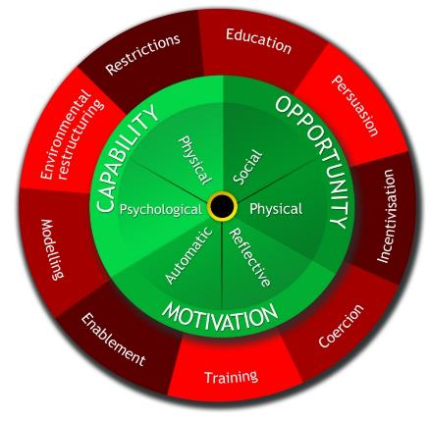
The BCW:
Use rules to reduce the opportunity to engage in the behaviour (or to increase behaviour by reducing opportunity to engage in competing behaviours)
Increase knowledge or understanding
Behavioural theory at its core
Use communication to induce positive or negative feelings to stimulate action
Nudge/ Change the physical or social context
9 Intervention Functions:
‘broad categories of means by which an intervention can change behaviour’
Create an expectation of reward
Provide an example for people to aspire to or emulate
Create an expectation of punishment or cost
Increase means
or reduce barriers to increase
capability (beyond education or
training) or opportunity
(beyond environmental
restructuring)
Impart skills

Slide 5
Plan to tackle 3Cs Prescribing
A retrospective trainee pharmacist audit
The last three oral acute prescriptions for either cefalexin, co-amoxiclav, ciprofloxacin, (OR ofloxacin and levofloxacin) for each prescriber from the 29th of October 2021 back to 29th of January 2021 were reviewed on S1 PCN includes 52 prescribers across 3 different sites; Some prescribers did not prescribe up to 3 items that could be included in the audit in this time frame therefore there is less than 52 x 3 = 156 prescriptions included
Exclusion criteria:
Specialist initiation
Long-term prophylaxis
Non-oral formulations
Prescription for neonate (<1 month old) – since guidelines aren’t as clear

Slide 6
The “decision, choice, dose, duration” framework was used to assess the antibiotic prescribing ¹
Decision: Was it the correct decision to prescribe an antibiotic?
Choice: Was the correct antibiotic chosen for the indication?
Dose: Was the correct dose (of the correct antibiotic) prescribed?
Duration: Was the correct duration (of the correct dose of the correct antibiotic) prescribed?
When deciding if the most appropriate choice was made certain factors were taken into consideration e.g. allergies, microbiology cultures, interaction with current medications, previous history of patient and previous prescribers decisions, in order to come to a realistic conclusion about what would have been the ideal outcome of each scenario.
Appropriate: The most appropriate choice by following guidance (taking into consideration allergies and culture results etc. of the individual patient that the prescriber would have had access to at the time of prescribing) e.g. if Pivmecillinam (second-line choice) was prescribed for a female with uncomplicated UTI as patient had ADR to nitrofurantoin (first-line choice) and culture sensitivities showed that UTI was resistant to Trimethoprim (also first-line choice)
Sub-optimal: The choice made was not the most appropriate but was still a part of the guidelines e.g. if Pivmecillinam (second-line choice) was prescribed for a female with uncomplicated UTI but there was no reason (e.g. allergies, culture sensitivities) that the patient couldn’t have had one of the first line choices of Nitrofurantoin or Trimethoprim.
Inappropriate: When the choice made did not follow any guidance e.g. if Cefalexin was prescribed for a female with uncomplicated UTI with no documentation to show why the first four choices recommended by SCAN guidance or NICE CKS were not chose
(1) McLellan L, Dornan T, Williams S, et al. Pharmacist-led feedback workshops increase appropriate prescribing of antimicrobials,
Journal of Antimicrobials & Chemotherapy, 2016;71(5): 1415-1425. https://doi.org/10.1093/jac/dkv482

Slide 7
Initial findings
Unclear guidelines for gynaecological issues across SCAN guidance, NICE CKS and RCOG (Royal College of Obstetricians and Gynaecologists)
Clear relationship between inappropriate Co-amoxiclav prescribing and skin infections
Clear relationship between inappropriate Cefalexin prescribing and urinary tract infections

Slide 8
Next steps...
Attempt to identify any further key issues as to when and why prescribers do not follow the most appropriate guidance
Give feedback to prescribers, individually and as a cohort, on how to improve prescribing adherence (BCW – Education)
Peer pressure (BCW – Modelling / Persuasion / Environmental restructuring or ? Coercion ? )
Clinicians have asked to use own data for appraisal documentation (BCW – Incentivisation or Coercion ? )

Slide 9
Plan to tackle Children’s Antibiotics
A GP registrar Quality Improvement
Retrospective review of under 18s prescribed antibiotics acutely for sore throat/tonsillitis Aug - Nov 2021 inclusive
Assessing if
Clinician used fever pain /Centor scores
Gave written safety netting advice
Prescribing matched NICE/SCAN guidance
Advised re delayed prescription
Questionnaire to clinicians re approaches to prescribing Antibiotics for children
Aim to use BCW Modelling / Enablement (AccuRx)
Notes:
Coffee room chats GP MINDLINES

Slide 10
Analgesic reviews in practice
Emma Davies
Advanced Pharmacist Practitioner in Pain Management
Cwm Taf Morgannwg University Health Board
Notes:
Hello everyone and thank you to Steve and the PrescQIPP team for inviting me to speak to you today. My name is Emma Davies and I’m an advanced pharmacist practitioner in pain management working in South Wales.

Slide 11
Aim
Provide some hints and tips around analgesic stewardship when undertaking medication reviews
Links to
PrescQIPP resources on opioids and chronic pain
Roger Knaggs Webinar on NICE CG193 – Chronic Primary Pain
Notes:
When Steve asked me to do this talk, he asked if I could provide some hints and tips for people undertaking structured medication reviews out in practice. You’ll note that I refer to analgesic stewardship here – I’ll explain more about that in a minute.
Hopefully, what I say today will make sense alongside other PrescQIPP resources on chronic pain, opioids and gabapentinoids - there’s some really helpful stuff on the website and great examples of other people’s work in this area that we can all learn from too. You may have joined the webinar last year with Dr Roger Knaggs who explained the recent NICE guidance for assessing chronic pain and managing chronic primary pain – I might forget to make direct reference to that today but it should be something to bear in mind when undertaking medicines reviews in this area.

Slide 12
Pain management
Analgesic reviews in practice
Commonly thought of as a multi-disciplinary approach to improving function, quality of life and reducing the impact of pain
Involves a range of methods including medicines, interventions, physiotherapy, psychology and promoting self-management
Notes:
I want to draw attention to a little distinction – I think it’s quite important in the context of medication reviews. I’m a pharmacist, I’m supposedly expert in medicines – I’d tend to say I specialise in medicines because I’m one of those that doesn’t believe in experts! By that I mean I don’t believe anyone knows everything about a subject, no matter how niche – how boring if they did, there’d be nothing new to find out. Anyway – I digress. As a pharmacist working in the sphere of pain management, I have frequently been reminded that as a pharmacist, I don’t possess the knowledge, skills or competence to undertake pain management. Based on this definition, no single professional does. However, we all, regardless of background or sector of work have an important role to take in improving access to pain management support and as a pharmacist, my particular area will obviously be medicines. As a person who works almost exclusively within the sphere of pain management, over the years and with various training courses, I have developed interdisciplinary knowledge and skills that enhance what I do as a pharmacist but certainly don’t make me a physio or psychologist or heaven forbid – anaesthetist! We all bring different skills to the party and an individual with pain is likely going to do better if they can take a little bit from all of us.

Slide 13
Analgesic stewardship
Analgesic reviews in practice
The aims of analgesic stewardship are to improve patient outcomes, reduce analgesic related harm and ensure cost-effective use of analgesics to provide optimal pain management
https://www.alfredhealth.org.au/services/pharmacy-at-alfred-health/about-alfred-health-pharmacy/centre-for-medicine-use-and-safety-cmus/cmus-stewardship-programs
https://www.tandfonline.com/doi/epub/10.1080/15360288.2020.1765066?needAccess=true
www.bettersafercare.vic.gov.au
Notes:
So, what is the thing I supposedly do best – this would be it. Analgesic stewardship.
I’ve taken this definition from Australian documents – they are pulling together some really great resources on this area and especially in regard of opioid stewardship. Reading it, let’s face it, you can substitute pretty much any drug group and any condition – essentially this defines what pharmacists and pharmacy technicians are working towards most of the time. I first coined the phrase analgesic stewardship in a text to the Chief Pharmaceutical Officer for Wales about five years ago and now wish I’d just written a paper about it instead. I think we’re going to start seeing this phrase more and more and I’d urge all pharmacists and members of the pharmacy team to grab it now and make it our own.

Slide 14
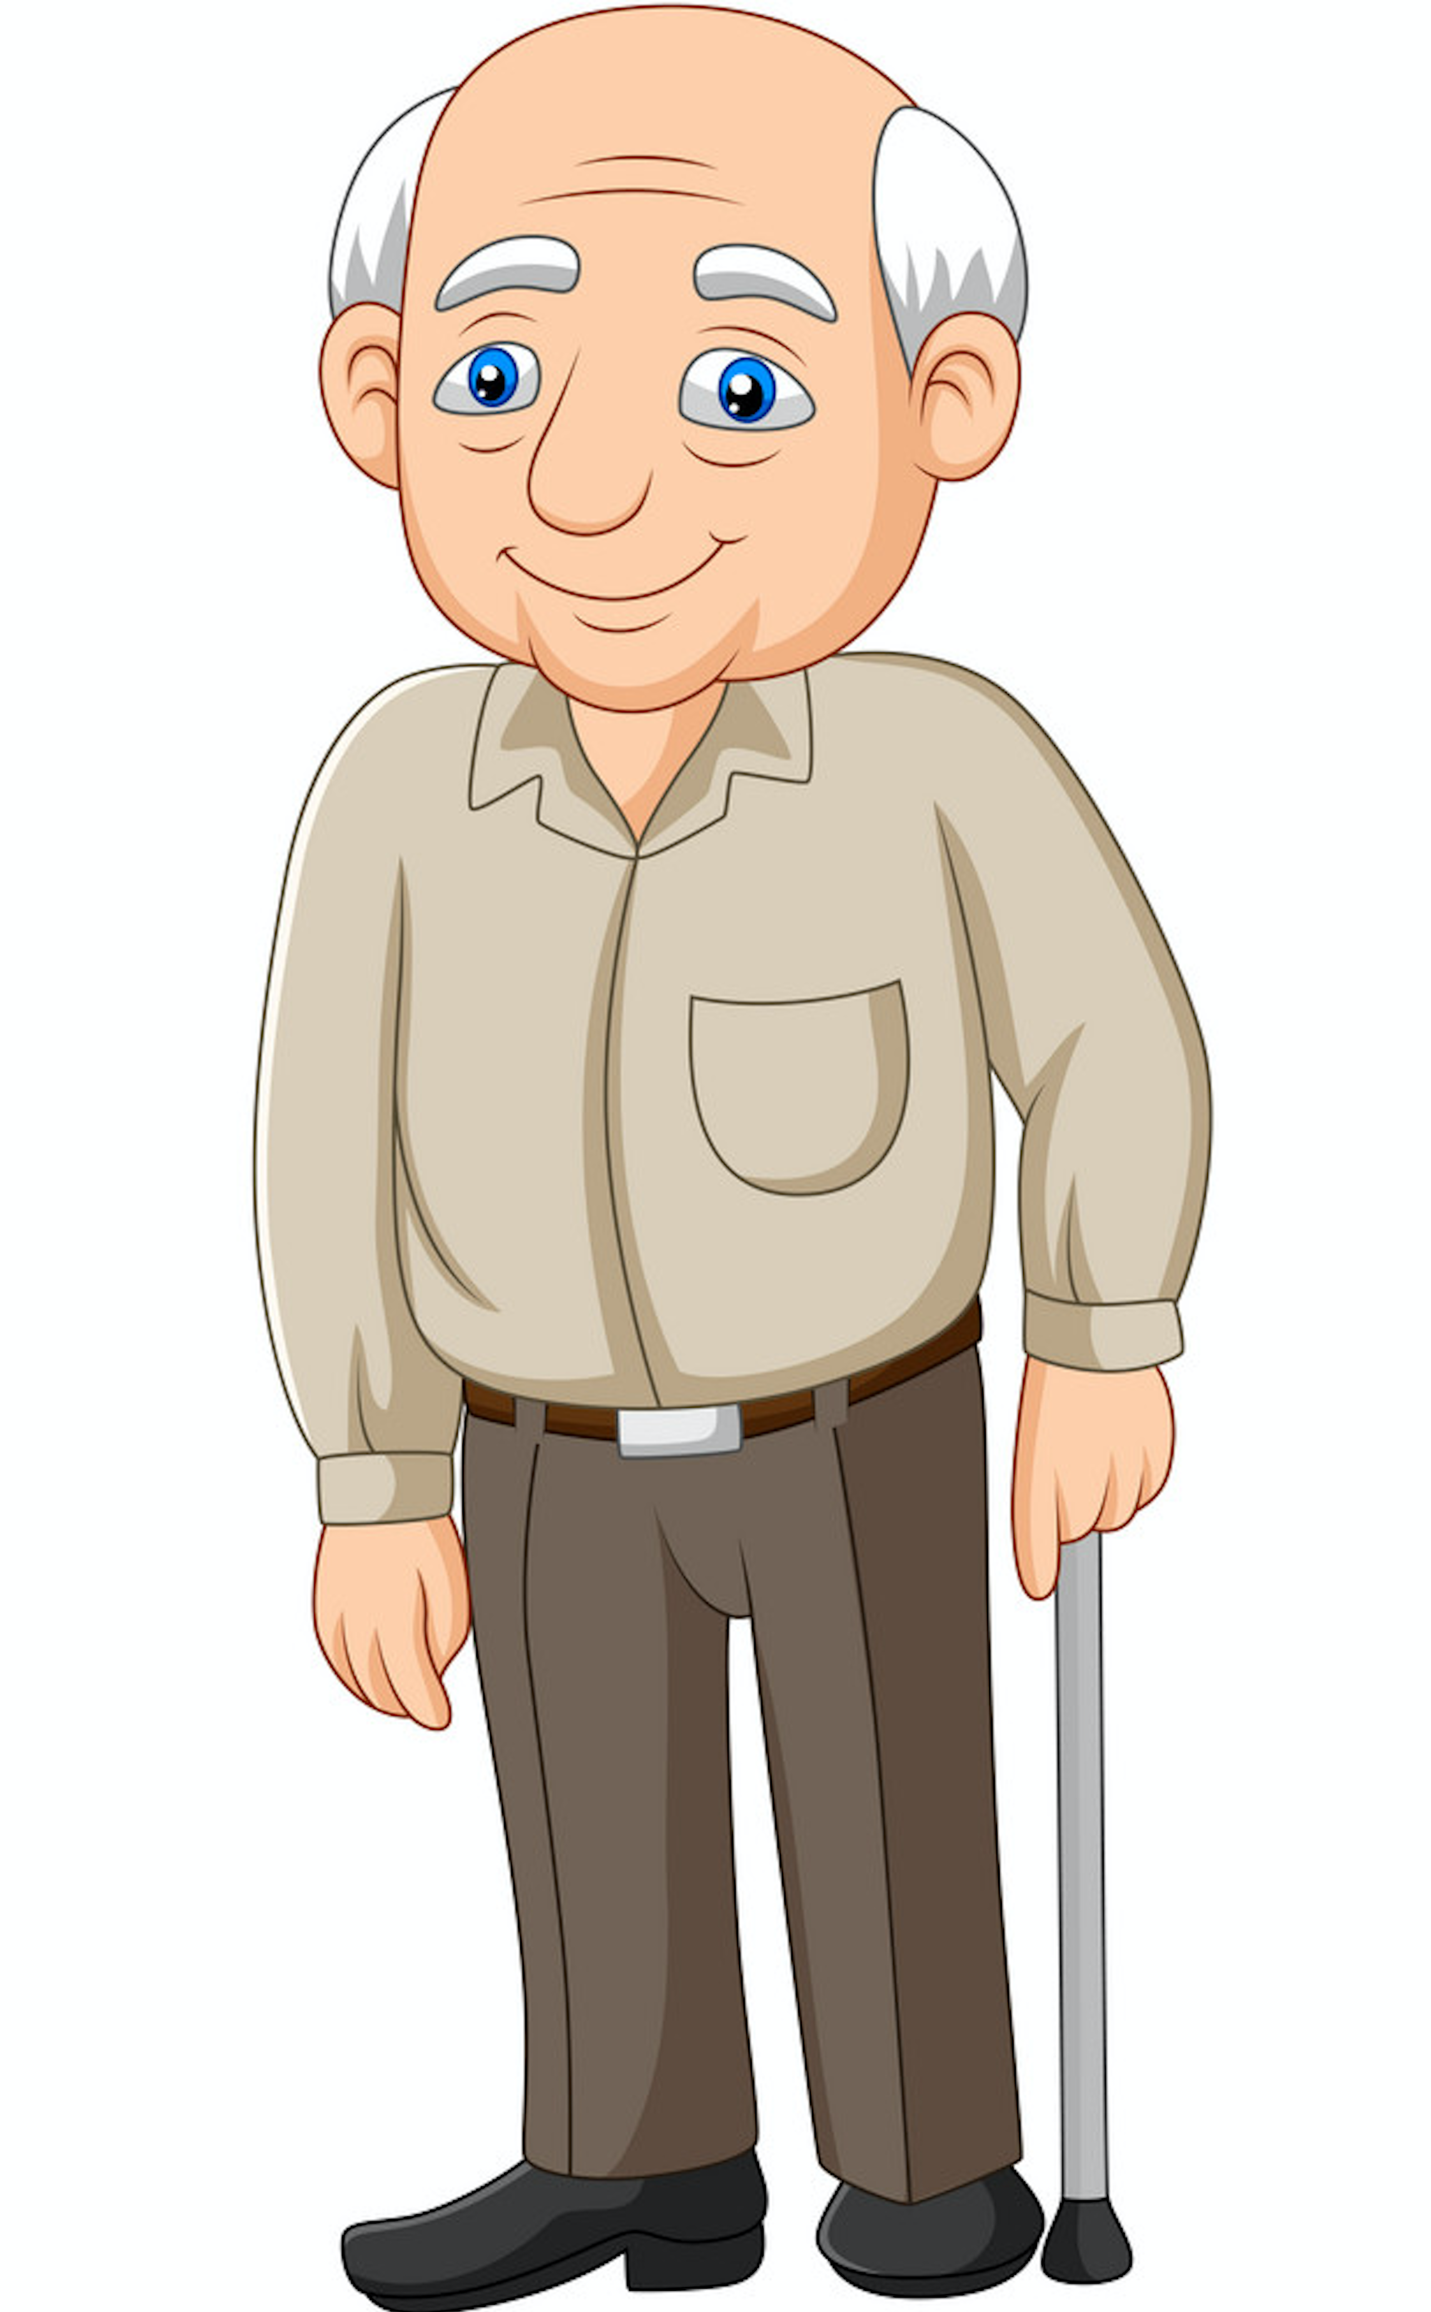
Analgesic stewardship in context
Analgesic reviews in practice
62-year-old man
MHx - OA knee, back pain, asthma, anxiety/depression, hypertension, hypothyroidism, BPH, osteopenia
Other- Presents frequently for rescue packs, pain reporting, awaiting knee replacement, states he has COPD
Notes:
So, lets think how this can work in practice.
A chap gets referred to the local primary care and community MDT for a general review – the GP highlights mobility issues, respiratory issues and difficulty engaging him. He has a number of diagnoses on his medical record and he contacts the surgery frequently, generally always in extremis based on his report but on further investigation, rarely has much changed.
Just this gives quite an insight into the patient. This is someone with genuine medical issues but who isn’t really managing very well. A lot of this could be due to poor understanding of the conditions he has – for example – he doesn’t have COPD but is convinced he does, so every time he feels breathless, he thinks he is having an infective exacerbation and starts on the rescue pack. I’m not going to comment on the practice giving the rescue packs every month, suffice to say – you might well be forming the impression that some of his health beliefs are possibly being reinforced by the practice giving medicines without question or review. Bear this in mind as we look at the list of his medicines and think about the previous slide and the questions such as ‘which medicines are essential’ because we as healthcare professionals and he as the person taking them, might have different answers to that.

Slide 15
Regular Medicines
Analgesic reviews in practice
Tamsulosin MR 400micrograms od
Fluoxetine 60mg om
Paracetamol 1g 4-6 hourly
Finasteride 5mg od
Gabapentin 900mg tds
Colecalciferol 800ui od
Levothyroxine 125micrograms od
Montelukast 10mg od
Lansoprazole 15mg om
Duoresp Spiromax 160/4.5micrograms bd
Longtec 60mg bd
Shortec 20mg qds
Acidex Advance 10-20mLs after meals and on
Salbutamol nebs as directed
Amitriptyline 50mg on
Amlodipine 5mg od
Doxycycline 100mg 2 on first day then od for 5 days
Prednisolone 40mg od for 5 days
Notes:
Medicines – my colleague on the MDT took one look at this list and phoned me. Looking at analgesic medicines in particular – the first thing that strikes you is the doses he is taking – bearing in mind this is a guy who reports high levels of pain and poor function. Everything is ramped right up – his daily oxycodone dose is roughly equivalent to 400mg oral morphine per day, gabapentin is a good old dose, amitriptyline and fluoxetine and a bit of paracetamol chucked in for good measure. He’s been on these medicines for a number of years at these doses – so I suppose we can be grateful they’re not higher perhaps.
Interestingly, a study of opioid prescribing from Meghna Jani’s group up in Manchester observed that people who received high initial doses of opioids or who had doses escalated in the first couple of years of treatment tended to remain on them at those doses. This corroborates other studies where although doses might initially escalate quickly, they reach a point where everyone says ‘enough’ and that’s where people get stuck.
So, what we have here is someone on a lot of analgesics, who is barely functioning and still complaining of pain, as well as having other conditions that he is finding equally difficult to live with. Now, as I said, this came to me because he was picked up through an MDT, but he could just as easily have emerged from a search in the practice for high dose opioids as part of a review and attempt to reduce prescribing. Or a similar search for medicines with high risk of dependence, one of the SMR categories in England.
1.Jani, M., Yimer, B. B., Sheppard, T., Lunt, M. & Dixon, W. G. Time trends and prescribing patterns of opioid drugs in UK primary care patients with non-cancer pain: A retrospective cohort study. Plos Med 17, e1003270-16 (2020).

Slide 16
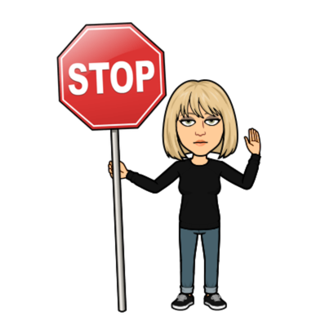
Stop Think Refocus
Analgesic reviews in practice
Notes:
So, what do we do here? This is a 62 year old bloke. He is taking very high doses of opioids and other analgesics. Is he dependent? Face it, we don’t actually know at this stage but chances are he is, because dependence is a physiological state occurring when you take a medicine and then take it away suddenly. Is this guy psychologically dependent – again, we don’t know yet but chances are, he feels he needs these medicines and anyway, the doctor prescribed them so they must be okay so there is a good chance he would be reluctant to stop them. Is that psychological dependence?
Now, we all know that opioids are really bad – we’ve all watched dopesick and read kingdom of pain. We all know opioids only work for about 10% of people who have them prescribed. We all know that doses above 120mg oral morphine equivalent per day are very unlikely to improve pain relief but very likely indeed to start causing harm. We all know that the biggest problem with opioids is addiction – don’t we? Do we?
Let’s think about that. Let’s bring it back to the person we are seeing here.

Slide 17
What are you trying to achieve?
Analgesic reviews in practice
Notes:
So, in the context of medication reviews, we really need to consider what we are trying to achieve. Here we are with our list of high dose opioid patients – remembering opioids are bad, we need to get all those people down and off them, because we know how bad they are and all the harm they can do. We’re doing medication reviews aimed at everyone on the highest doses or in combination with other bad medicines like gabapentinoids and the aim for this year is to get our prescribing down into the lowest quartile, so let’s go, lets do it. Because reducing medicines is pretty straightforward, it’s basically just a logistical exercise and because I know loads about medicines, and everyone knows the problems with these drugs, I’ll just have to say we need to reduce your opioids and this guy will be so grateful I’ve saved his life – I’ve read the guidance and basically, if you reduce by 10% of the total dose of opioid every week – well, we could have this all done by a month next Sunday. Awesome.
Just one thing …

Slide 18
Analgesic reviews in practice
Hypertension
Amlodipine
BPH
Tamsulosin
Finasteride
Depression
Fluoxetine
Pain
Longtec
Shortec
Gabapentin
Amitriptyline
Paracetamol
Respiratory
Montelukast
Duoresp Spiromax
Salbutamol
Doxycycline
Prednisolone
Osteopenia
Colecalciferol
Hypothyroidism
Levothyroxine
Other
Lansoprazole
Acidex Advance
Notes:
One of the problems of specialization is that we tend to work in silos – we see it all the time from secondary care clinics. You go to see a cardiologist – they make recommendations about the cardiac medicines but haven’t necessarily considered how that might affect the person’s respiratory needs for example? Same with pain – someone goes to pain clinic and surprise surprise, we get recommendations for analgesics and it is often primary care having to go back and say, you know what – that isn’t actually a great idea in light of all the rest of the patient. What can happen then is that the patient starts segregating their conditions too and start to those themselves in all the mess.
If you’re reviewing analgesics you may find that the person doesn’t always leap on board with the idea that because they are still in pain, the analgesics aren’t working – this was certainly the case with this man. Living with pain is hard work and can be scary and the idea of taking medicines away, especially the ones called ‘painkillers’ sounds preposterous. What else could we say? That we have to reduce them because the evidence states they are harmful or because the health board has set a target for reductions or that we think you’re probably addicted or dependent. The conversation about dependence can be pretty difficult. Pharmacologically, most people who are regularly taking opioids and especially modified release opioids will have a physical dependence and stopping them too quickly would very likely lead to withdrawal. This chap was very keen to tell me he wasn’t addicted but that he needed them.
Think back though earlier when I mentioned that he was a frequent contacter of the practice, the monthly rescue packs etc. This guy was really focused on his ill-health and he definitely had lots of diagnoses. If you are really fraught about your health generally, your self-image is that you are sick, then the thought of getting worse isn’t great. People take medicines in good faith, in the same way that in the vast majority of cases they are prescribed that way too. But over time, even if the medicines don’t change, the person does and it becomes the case that new symptoms or changes in condition are put down to bad luck, bad health.
So, my main concern and what I had been asked to help with was the analgesics. Was I concerned about dependence – not really, it’s a given in these situations and I generally don’t find it helpful to bring it in too early. What I focus on, is how analgesics might be affecting the person more widely – how they might be affecting other conditions the person has.
With this chap, there was a lot to choose from – amitriptyline and his BPH, opioid induced endocrine dysfunction, paracetamol has been associated with adverse effects similar to NSAIDs, including GI ulcer, opioid associated osteopenia and osteoporosis, increased risk of falls and fractures, opioids are also associated with recurrent or worsening depression and gabapentin can also cause depressed mood. The big one though for this guy, was the respiratory concerns he had so spending time explaining the how opioids and gabapentinoids can cause ventilatory impairment. This really hit home with him and his wife.
This comes back to that question about adverse effects – how the heck would he know? So, what problems is he experiencing and link them back to the medicines he is taking. By making the link between the drug I’m concerned about, in this case firstly the opioids, and his own health concerns, it leads back to the ‘what matters to you?’ question. Because one of the things that mattered to him was not getting any worse. It was helped by his wife who said that in spite of all these medicines, he was worse than when this all started and she’d wondered herself if the medicines were part of the reason. This was the point I was able to bring in the concept that perhaps the ‘painkillers’ weren’t actually helping and that actually, the doses he was taking were so high, they might actually be making the pain worse.
By linking to his other conditions, he realised that actually, the problem with the opioids and other analgesics was more than simply not working well for pain. He started to understand that reducing them might be beneficial overall and perhaps the payoff to him might outweigh the downside, even if his pain increased a bit. Importantly, he’d never had this information before. Perhaps if he had – earlier on, before the doses got so high and the risks so great, he might have stuck with other options like physio and functional restoration work a bit more diligently. This conversation was late but if we could start having them at initiation or at least before dose escalation gets out of hand, I think it would make a big difference.
This consultation was done in person with bloke and his wife in their home. This makes things much easier but whether in person or otherwise, sometimes we need a bit of a hand to get the message across. I want to quickly run through a few tools I use in that might be helpful.

Slide 19
Analgesic reviews in practice
Notes:
The man I’ve been talking about was prescribed 400mg oral morphine equivalent per day. I think we often talk about high dose opioids but how do we put that into context for the person taking them? How would they know what is considered a high dose. For example, the guy in my case was prescribed 900mg gabapentin each time so to him, 60mg oxycodone wasn’t that much – he was on way more gabapentin. This is also a problem for lots of prescribers, who don’t quite ‘get’ equivalences. One tool that might help is the opioid thermometer. It is something I came up with alongside Professor Nina Barnett – brilliant pharmacist but who said to me that she didn’t always feel confident about opioid equivalence and what a high dose of a non-morphine medicine was.
This can help people see it and it may help contextualise it with what they’ve taken before or perhaps compared to what someone else they know is taking.

Slide 20
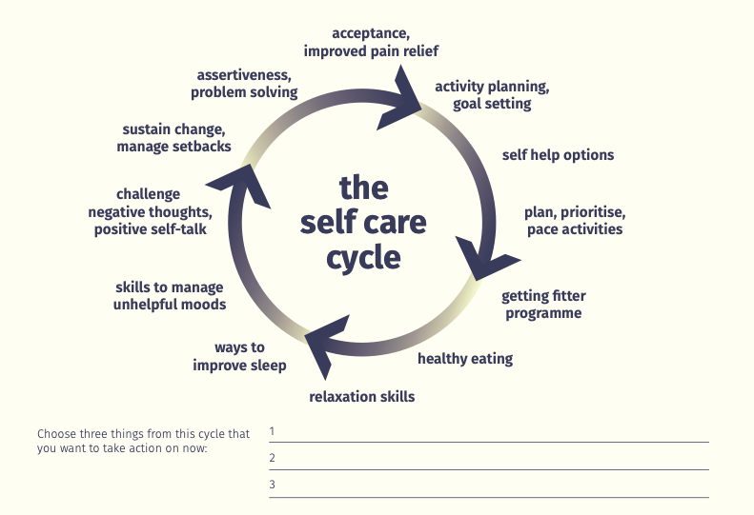
Notes:
Another thing we can do during analgesic reviews is to get people to start thinking about how pain is linked to other parts of their life and experience. This can help move the conversation to a point where we can start talking about how medicines might not be helping with certain parts of the cycle or perhaps, if they were started for that purpose but it hasn’t improved, is it worth thinking about something else instead – this is where me as a pharmacist can start moving the conversation from analgesic stewardship towards pain management. So if looking to reduce medicines, perhaps we can consider introducing a self-management trial as the alternative – giving people other options to live more effectively with their pain can help reduce their reliance on analgesics and improve their quality of life in other ways.

Slide 21
Making reductions
Analgesic reviews in practice
Notes:
Finally, it wasn’t my intention to cover reductions in any detail but if you are tapering analgesics – there are some basic things to bear in mind. It is really difficult to produce guidelines for reducing as really, the process needs to be done in conjunction with the individual and take their particular circumstances into account. Some people are keen to come off their analgesic quickly, once the decision is made. We must explain that withdrawal is expected and take steps to mitigate it as far as possible. The best way to achieve that is to keep dose changes small – with opioids, 10% or less of the total daily dose if possible or the smallest available dose if not quite. Speed matters – especially in a primary care setting where people can’t be monitored round the clock and where they are also dealing with other stuff, life getting in the way, other conditions to manage and so on. Unless someone is considered to be in immediate risk for example, if they are experiencing ventilatory impairment such as falling asleep and being difficult to rouse, or falling back to sleep after being roused – then it may be better to go slowly or take breaks from reducing from time to time. If we think about safety then any reduction moves the person towards a safer place and that is a good thing.

Slide 22
Summary
Analgesic reviews in practice
Don’t assume you have the same priorities as the patient
What do they already understand about their medicines and their condition(s)
What are their concerns
Think about what is important
Safety
Efficacy
Patient’s needs
Focus on manageable change
This is not a logistical exercise it is someone’s life
Notes:
So, to summarise. We must undertake reviews of analgesics – we prescribe a lot of them and they are probably not helpful for the majority of people receiving them, possibly making other health conditions harder to manage, into the bargain. We need to explain our concerns to the people we support but ensuring we place them into a context that fits with their own thoughts and concerns.
Yes, we are concerned about safety and efficacy but we also need to consider what the person taking analgesics needs as well. If they don’t think they have any other means of living with pain, taking away pain relief becomes immediately more difficult. Sometimes, we will have to reduce analgesics, whether the person likes it or not and many will actually thank you for it afterwards and when some of the unrecognized side effects alleviate, but it can be a rough road. Whilst in theory, tapering analgesics is just an exercise in reducing a dose by a percentage every couple of weeks, that isn’t how it might feel to the person taking them. Linking to other conditions and talking about function, what they do rather than pain intensity can be a positive way of engaging the individual and helps them to monitor their progress in a positive way. It isn’t all about addiction and dependence when it comes to analgesics - it should be quality of life improvements.

Slide 23
Future Practice Plus Webinars
Date | Key themes | Guest Presenters
March 9th 2022 | Electronic Detailed Medication Review Toolkit | Briony Leighton | Clinical Pharmacist (Arrow Health PCN) Primary Integrated Community Services Ltd Nottingham
April 20th 2022 | Caring for a patient with CKD post NICE 2021 guidance | Natasha Moore Advanced Renal Pharmacist Guy’s and St Thomas’ Hospital
18th May 2022 | Population Health Management : How can it help you with planning SMRs ? | Dr Wasim Baqir Senior Pharmacist Pharmacy Integration Programme Primary Care, NHS England and Improvement

