Slide 1
Practice Plus Webinar 9th March 2022
Steve Williams
Lead Clinical Pharmacist PrescQIPP Practice Plus

Slide 2
Agenda
Time | Title | Presenter
12.45 | Welcome, introduction and reflections STOP, THINK, RE-FOCUS Influencing / Leadership re new IIF MO targets | Steve Williams
1.00 | Electronic Detailed Medication Review Toolkit Q & A | Briony Leighton | Clinical Pharmacist (Arrow Health PCN) Primary Integrated Community Services Ltd Nottingham
1.40 | Future PrescQIPP Webinars | Steve Williams
Notes:
Feedback Abs
Emis + Tpp antibiotic + Feverpain protocols from BANE being tested by PQ for antimicrobial stewardship resources being updated at present
Feedback Emma
I felt that Emma's presentation was very informative and delivered confidently. I am a pharmacy technician and I didn't feel that it went over my head.
Extra q and a on Slack
back after NICE guidance on dependence forming meds comes out later in year
Managing SMR in people without capacity (frail, elderly, dementia in care homes) and persuading NoK to consider efficacy of analgesia - can Emma do a session on that please?

Slide 3
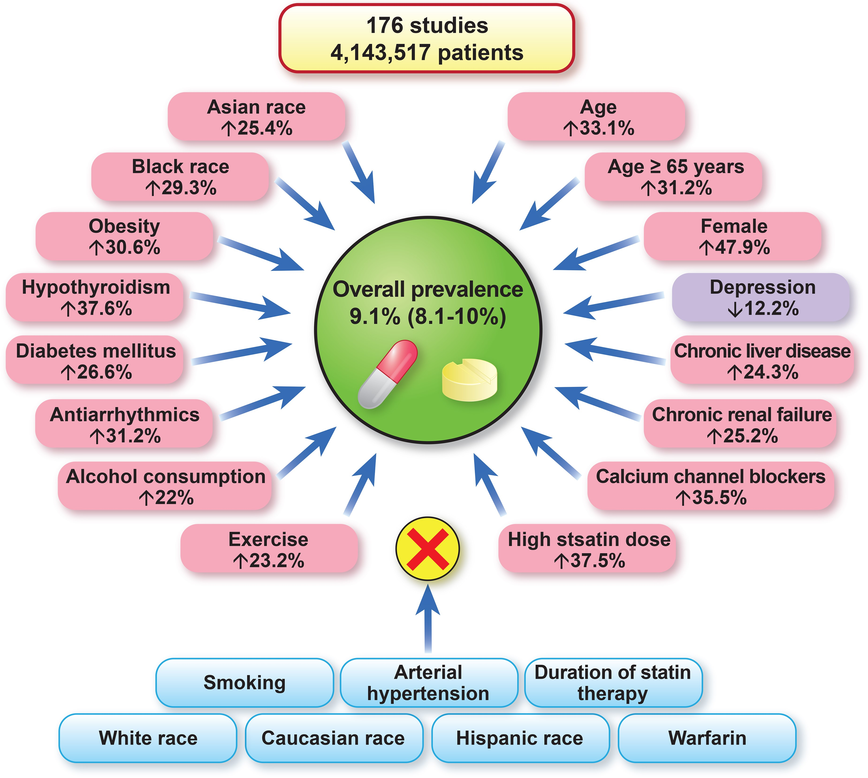
The worldwide prevalence of statin intolerance and risk factors /conditions that effect or do not effect the risk of statin intolerance
Notes:
Unless provided in the caption above, the following copyright applies to the content of this slide: © The Author(s) 2022. Published by Oxford University Press on behalf of European Society of Cardiology. All rights reserved. For permissions, please e-mail: journals.permissions@oup.comThis article is published and distributed under the terms of the Oxford University Press, Standard Journals Publication Model (https://academic.oup.com/journals/pages/open_access/funder_policies/chorus/standard_publication_model)

Slide 4
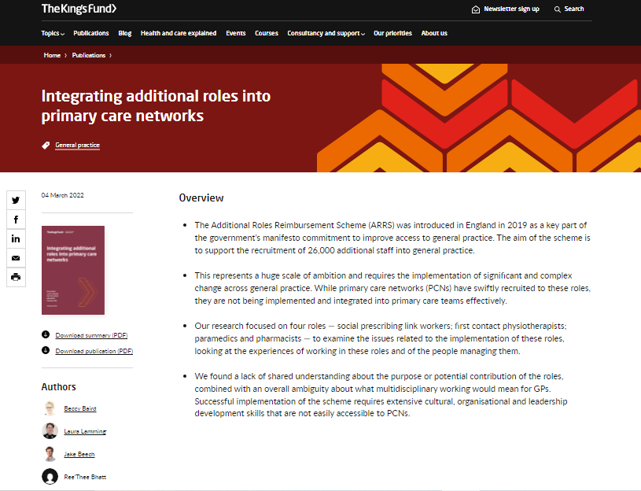
Notes:
https://www.kingsfund.org.uk/publications/integrating-additional-roles-into-primary-care-networks

Slide 6
Electronic Structured Medication Review (SMR) Templates
Briony Leighton
Clinical Pharmacist
Stephen Murdock
Head of Primary Care IT

Slide 7
Background: The journey!
Multiple GP systems
Numerous sources of information
Complex patients
Pro-active SMRs
Preparing a SMR
Documentation
No set format

Slide 8
Potential Solution:
Consistent format
Collate information
Electronic checklist / prompts
Embedded toolkits
Consistent documentation
Read codes & data capture
Questionnaire 7 steps
NOT a decision-making tool.
Does NOT replace clinical judgement

Slide 9
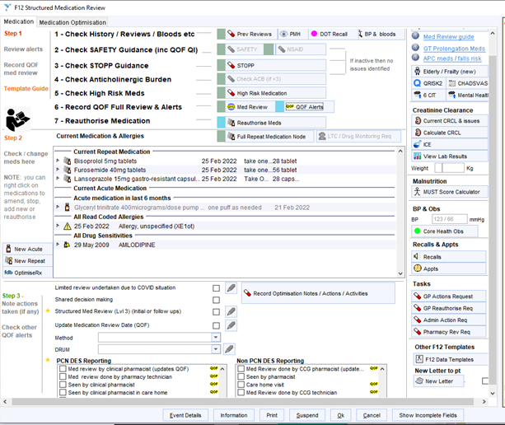
SMR Template

Slide 10
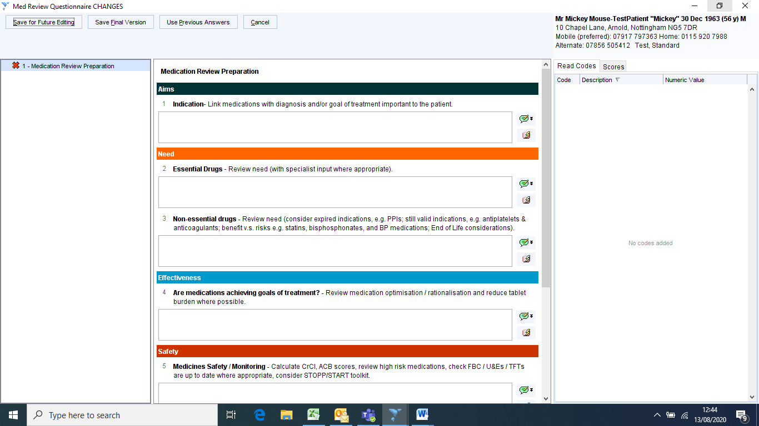
SMR Questionnaire:

Slide 11
Considerations
SMR working group
Collaborative working
Stakeholder engagement
Links to Medicines Safety
Information Governance
Potential future toolkits
High risk drug monitoring
Potentially addictive pain medications
DOAC prescribing
Uniformity and consistency

Slide 12
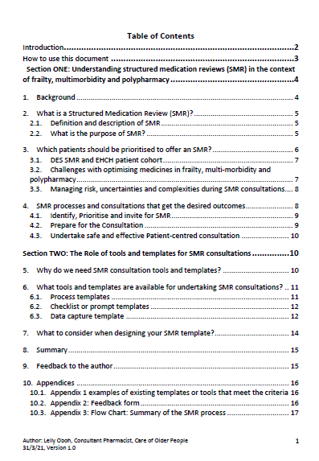

Slide 13
Future Practice Plus Webinars
Date | Key themes | Guest Presenters
April 27th 2022 | Caring for a patient with CKD post NICE 2021 guidance | Natasha Moore Advanced Renal Pharmacist Guy’s and St Thomas’ Hospital
18th May 2022 | Population Health Management : How can it help you with planning SMRs ? | Dr Wasim Baqir Senior Pharmacist Pharmacy Integration Programme Primary Care, NHS England and Improvement

