Slide 1
Practice Plus Webinar 27th April 2022
Steve Williams
Lead Clinical Pharmacist PrescQIPP Practice Plus

Slide 2
Caring for a patient with Chronic Kidney Disease (CKD)
Natasha Moore
Highly Specialised Pharmacist
Chronic Kidney Disease
April 2022
Notes:
I was invited to come and present to you today to talk about chronic kidney disease and how to care for these patients practically in the primary care setting.
I have not worked in primary care for a number of years now, I'm very hospital focused- so I’m treating this as a learning session as well where I can tell you how to care for our patients practically in the community and how to monitor, and you can feed back to me and see if we are being unrealistic!
So I can check background background of audience-can people let me know if they are pharmacists/ techs? Prescribers? How many had renal experience? How many patients do you see with renal impairment? Do you check patients for renal impairment routinely?
Typically, our renal patients are managed very closely by the hospital, especially in the later stages of CKD, and they have lots of contact with secondary care whether that’s being worked up for a renal transplant, moving towards dialysis, or supportive care if they chose. However, what I hope to gain from this session is to give you, our primary care colleagues, the confidence to help manage these patients more in the community, to understand why we have recommended certain medication, and also how to medically optimise these patients through medication reviews and SMR- unfortunately I see a lot of patients come to us with irreversible, and arguably preventable kidney damage, so you play a vital role in the prevention and slowing of kidney disease.

Slide 3
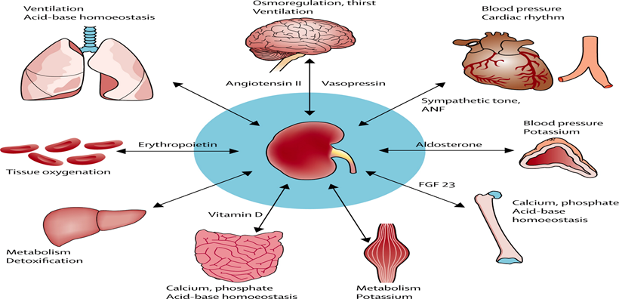
What do your kidneys do?
Notes:
Basic question isn’t it? And our patients know- don’t they??- but when the general public were asked questions as part of “think kidneys” project showed that only 51% of our patients know that the kidneys make urine!
So a take away message here is don’t assume your patients know- and if they don’t know the basics of what the kidneys do, they are less likely to know all the other work they perform, and therefore all the different effects having Chronic kidney disease can have on many parts of the body- not just renal impairment.
As you can see from the diagram above, the kidneys have many far reaching effects on the body, so they don’t just make urine! Did you all know all of theses?
Chronic kidney disease is defined as having some type of kidney abnormality, or "marker", such as protein in the urine and having decreased kidney function for three months or longer. Leading cause is diabetes, followed by HTN. Prevention begins in primary care!
. I run patient education sessions for our patients who are later stage CKD. A lot of the education session is about the changes to expect- a lot of patients blame the medication for the tiredness/ itching/ nausea, not realising that it is difficult to distinguish between side effects from medication vs progression of CKD.

Slide 4
Chronic kidney disease: assessment and management
NICE guideline [NG203] Published: 25 August 2021 Last updated: 24 November 2021
New and updated recommendations for:
Investigations for CKD
Classification of CKD
Frequency of monitoring
Risk assessment, referral criteria and shared care
Blood pressure control
Medicines for CKD
Phosphate binders to manage mineral and bone disorders
Glomerular filtration rate for diagnosing anaemia associated with CKD
Intravenous iron for treating anaemia associated with CKD
Notes:
Big overhaul, lots of changes to the guidance- I'm going to talk about the main ones that you will see in practice, however there's not enough time to cover all of the areas to day in lots of detail.
I've added hyperlinks to the headings and subheadings so if you get a copy of theses slides you can just click on them to find the guidance.
The update in November shortly after the original update in August was to update the guidance on or those with markers of kidney damage in the urine.

Slide 5
Investigations for CKD
Why?
BNF states “Renal function should be checked before prescribing any drug which requires dose modification”
Who?
Older patients, Family history, Diabetes, Hypertension, Autoimmune diseases, UTI, Prescribed medicines with a narrow therapeutic index / requiring therapeutic drug monitoring
How?
Serum creatinine, urea, potassium, bone profile, Urinalysis and daily weight
Urine output – volume
Oliguria <500ml / 24 hrs
Anuric <200ml / 24 hrs
Polyuric >500ml / 24 hours
Urine output – appearance
Colour – haematuria (red/pink/brown)
Bodies – cells or casts
Cloudy – infected ? or precipitation of a medicine
Frothy – Protein (usually ≤ 150mg/day)
Notes:
First update im going to talk to you about is the “investigations for CKD”
Brief reminder of why/who and how we measure renal function as revision:
Why?
Early detection of renal impairment to prevent progression
Identify the cause of renal disease
Measure/monitor disease progression
Inform appropriate drug choices
Calculate appropriate drug dosing
Reduced renal excretion of a drug or its metabolites may cause toxicity
Sensitivity to some medicines is increased
Many side-effects are poorly tolerated by this group
Some medicines are not effective when renal function is reduced e.g. nitrofurantoin
Many of these problems can be avoided by:
Reducing the dose or frequency of dosing
Using alternative medicines
Daily weight
Urea
Potassium, calcium, phosphate

Slide 6
Cockcroft & Gault
Estimating GFR
e-GFR /MDRD
CKD-EPI
Advantages
Quick & Easy
Bedside calculation
Basis for most drug adjustments
Disadvantages
Inaccurate if:
very low GFR due to active tubular secretion
Extremes of weight & Age
Muscular
Assumes stable Creatinine
Validated against 24hr urinary creatinine collection
Advantages
Automatic reporting with BCPs.
No need for calculation
Does not require patients weight***
Majority of medicines
Validated against isotopic measurement of GFR
Disadvantages
***Stated as GFR per 1.73m². Need to adjust for BSA.
Not validated in: Children, pregnancy, AKI, Oedematous states, Amputees, malnourished, transplants, diabetes
Advantages
Performs better in normal/mildly reduced eGFR and just as well in eGFR<60mls/min/m²
2021 version has removed the race component
Disadvantages
Use in stable kidney function
Less accurate in Diabetes, pregnant women, unusal body mass
Not for patients on dialysis
Notes:
Actual GFR is measured by injecting a small amount of radioactive substance and then monitoring the rate of travel trough the kidney- eg inulin clearance. Very rarely used! Only really in clinical trial settings when accurate GFR needs to be measured.
Instead we need a bedside method of calculation that can be done quickly to estimate the renal function. So we use serum creatinine
Creatinine muscle breakdown product, freely filtered by kidneys so therefore the rate of excretion related to renal function BUT there is an element of promimal tubular secretion.
-is affected by protein intake an 8oz steak can raise creatinine by unto 30%
-at very low GFR may over estimate by 10-20% due to (proximal tubular secretion of creatinine)
-body builders
e-GFR may be used for majority of drugs, but those with a narrow
therapeutic window should not be adjusted according e-GFR
New guidance removes ethnicity adjustment in these calculations- recognises that it is about looking at the individuals age/weight muscle mass etc rather than blanket adjustment for ethnicity, which can overestimate kidney function in ethnic groups and reduce the likelihood of CKD being recognised, to further increasing the health inequality these groups face.
6

Slide 7
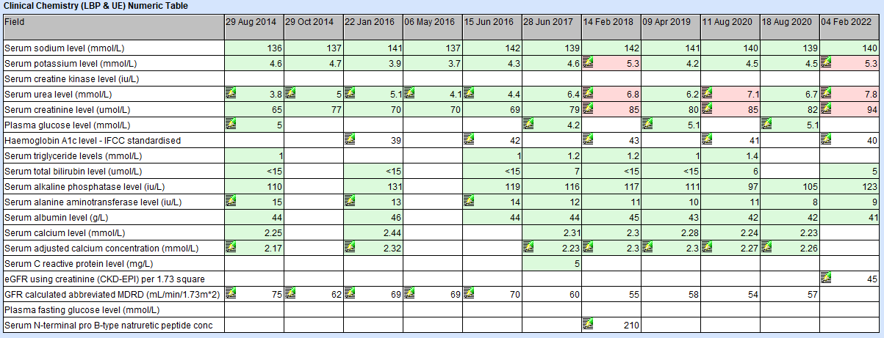
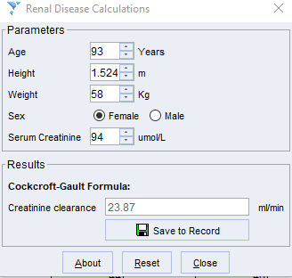
Cr Cl v eGFR for dosage adjustment
Notes:
So which calculation do we use??
Need to look at patient as a whole- and also it is all about trends
Thank you to steve Williams who provided this slide
See the rise in creatinine is highlighted but the patient is “green” even though her renal function is………
Warnings: look at patient as a whole!
Patient is 93! Lots not validated for this extreme of age, however.. Also look at the patients weight and height.
Her IBW is 45.5kg
CKD-EPI 49mls/min/1.73m2
But her BSA is 1.57m2
eGFR with CKD epi is 44.46mls/min
Using C+G – using actual weight gives 30mls/min, Ideal weight = 24mls/min
See the range of results you can get for the same patient so which one?! I would say it depends on the drug and what you are trying to treaT.

Slide 8
Classification of CKD
 | ACR category A1: normal to mildly increased (less than 3 mg/mmol) | ACR category A2: moderately increased (3 to 30 mg/mmol) | ACR category A3: severely increased (over 30 mg/mmol)
GFR category G1: normal and high (90 ml/min/1.73 m² or over) | Low risk No CKD if there are no other markers of kidney damage | Moderate risk | High risk
GFR category G2: mild reduction related to normal range for a young adult (60 to 89 ml/min/1.73 m²) | Low risk No CKD if there are no other markers of kidney damage | Moderate risk | High risk
GFR category G3a: mild to moderate reduction (45 to 59 ml/min/1.73 m²) | Moderate risk | High risk | Very high risk
GFR category G3b: moderate to severe reduction (30 to 44 ml/min/1.73 m²) | High risk | Very high risk | Very high risk
GFR category G4: severe reduction (15 to 29 ml/min/1.73 m²) | Very high risk | Very high risk | Very high risk
GFR category G5: kidney failure (under 15 ml/min/1.73 m²) | Very high risk | Very high risk | Very high risk
ACR = albumin creatinine ratio
CKD = chronic kidney disease
GFR = glomerular filtration rate
Major Risk factors for progression of CKD
Hypertension
Diabetes
Proteinuria / albuminuria
Other significant risk factors…
Cardiovascular disease
Obesity
Smoking
Hyperlipidaemia
Age
NSAID use
Notes:
Classification of CKD places emphasis on the increased risk of adverse outcomes
We still use categories 1-5 ( 1 being the least decline in kidney function, 5 being the worse kidney function- and moving towards needing dialysis/ transplant.
increased ACR is associated with increased risk of adverse outcomes
decreased GFR is associated with increased risk of adverse outcomes
increased ACR and decreased GFR in combination multiply the risk of adverse outcomes
Chronic kidney disease (CKD)
Abnormalities of kidney function or structure present for more than 3 months, with implications for health. This includes all people with markers of kidney damage and those with a glomerular filtration rate (GFR) of less than 60 ml/min/1.73 m² on at least 2 occasions separated by a period of at least 90 days (with or without markers of kidney damage).
Classification of CKD
CKD is classified according to estimated GFR (eGFR) and albumin:creatinine ratio (ACR) (see table 1), using 'G' to denote the GFR category (G1 to G5, which have the same GFR thresholds as the CKD stages 1 to 5 recommended previously) and 'A' for the ACR category (A1 to A3), for example:
A person with an eGFR of 25 ml/min/1.73 m² and an ACR of 15 mg/mmol has CKD G4A2.
A person with an eGFR of 50 ml/min/1.73 m² and an ACR of 35 mg/mmol has CKD G3aA3.
An eGFR of less than 15 ml/min/1.73 m² (GFR category G5) is referred to as kidney failure.
Glomerular filtration rate (GFR)
This is abbreviated in the following way in this guideline:
GFR: either a measured or an estimated GFR
eGFR: estimated GFR (without indicating the method of estimation)
eGFRcreatinine: an estimation of GFR using serum creatinine
8

Slide 9
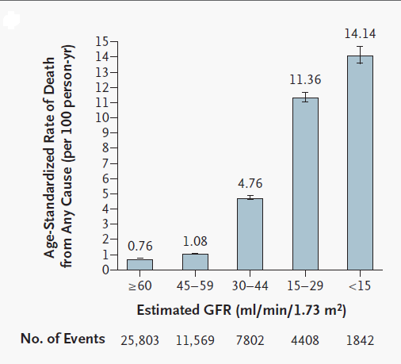
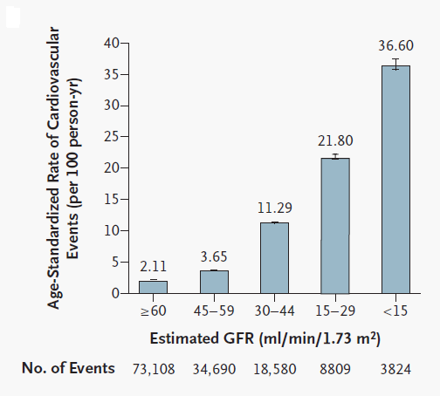
What is the extent of risk?
N = 1,120,295 adults. CV = cardiovascular. *Age-standardized rates per 100 person-years; †CV event defined as hospitalization for coronary heart disease,
heart failure, ischemic stroke, and peripheral arterial disease per 100 person-years.
Go et al. N Engl J Med. 2004;351:1296-1305
Notes:
As you can see, the lower the egfr, the greater the chances of dying from any cause.
And your risk of experiencing a Cardiovascular events is inversely proportional to the eGFR.
( these graphs are standardized for age.
This is where you come in: prevention!
Renal Association Guideline
Cardiovascular risk in CKD
Prevention (primary & secondary)
In line with NICE guidance
Exercise
Smoking cessation
Diabetic control
Blood pressure control
Cholesterol/statins
N = 1,120,295 adults. CV = cardiovascular. *Age-standardized rates per 100 person-years; †CV event defined as hospitalization for coronary heart disease, heart failure, ischemic stroke, and peripheral arterial disease per 100 person-years.
Go et al. N Engl J Med. 2004;351:1296-1305.
This is where you come in: prevention!
Renal Association Guideline
Cardiovascular risk in CKD
Prevention (primary & secondary)
In line with NICE guidance
Exercise
Smoking cessation
Diabetic control
Blood pressure control
Cholesterol/statins
9

Slide 10
Hypertension –Targets and management
See NICE's guideline on hypertension in adults for advice on blood pressure control in people with frailty and multimorbidity.
Targets
Patients with CKD and ACR <70mg/mmol target 140/90
Patients with CKD and ACR >70mg/mmol target 130/90
If ACR <30mg/mmol, follow NICE guidelines
If ACR >30mg/mmol offer ACEI/ARB
If diabetic start ACEI/ARB if ACR >3mg/mol
Number of Antihypertensives increases as GFR declines
Caution
Elderly – Risk of falls
Hypoperfusion of kidneys – AKI
Notes:
The new guidelines, no real changes in practice with targets, but emphasisi on starting ACE and ARBs in those patients it would be benefitical for. There is a big reluctance to start ACE?ARBS in this population group as precribers are worried aboutaffecting kidney function/ raising potassium.
We measure the amount of protein in the urine using uACR- and treat accordingly.
PCR or ACR favoured over proteinuria (measured in g/day)
Microalbuminuria is <30mg/dl (not detectable on a urine dipstick test)
Higher the PCR the lower the target BP
Albumin creatinine ratio (ACR)
Protein creatinine ratio (PCR)
Results from a meta-analysis (including the SPRINT trial) showed no meaningful difference between standard and more intensive blood pressure targets for adults with CKD. The 2014 guideline recommended maintaining systolic blood pressure below 140 mmHg and diastolic blood pressure below 90 mmHg. This is consistent with clinical practice and with the NICE guideline on managing hypertension. The committee noted that although there is limited evidence on blood pressure targets in people with CKD and proteinuria, it is important to maintain a systolic blood pressure below 130 mmHg and a diastolic pressure below 80 mmHg.
The committee agreed that none of the evidence they had seen warranted changing the recommendations. They also noted that intensive blood pressure targets only result in a marginal reduction in stroke and kidney failure, but put a large burden on patients in terms of polypharmacy and associated risks and side effects (such as falls).
The committee agreed that a useful target for blood pressure in children and young people with CKD and proteinuria is a systolic blood pressure below the 50th percentile for height.
The committee agreed that particular care had to be taken with people who were frail or who had multiple morbidities. However, the NICE guideline on hypertension already covers this group, so the committee did not make new recommendations.
10

Slide 11
ACEI / ARBs slow progression of renal disease
What is an acceptable change?
small rise in creatinine
<20% increase from baseline creatinine
OR
<15% fall in GFR
Notes:
Renin–angiotensin system antagonists
1.6.13 Do not offer a combination of renin–angiotensin system antagonists to adults with CKD. [2014]
1.6.14 Explain to adults with CKD (and their family members or carers, as appropriate) who are prescribed renin–angiotensin system antagonists about the importance of:
achieving the optimal tolerated dose of renin–angiotensin system antagonists and
monitoring eGFR and serum potassium in achieving this safely. [2008]
1.6.15 Measure serum potassium concentrations and estimate the GFR before starting renin–angiotensin system antagonists in people with CKD. Repeat these measurements between 1 and 2 weeks after starting renin–angiotensin system antagonists and after each dose increase. [2008]
1.6.16 Do not routinely offer a renin–angiotensin system antagonist to adults with CKD if their pretreatment serum potassium concentration is greater than 5.0 mmol/litre. [2008, amended 2014]
1.6.17 If an adult cannot use renin–angiotensin system antagonists because of hyperkalaemia:
assess for and treat any other factors that promote hyperkalaemia and
recheck serum potassium concentration. [2008]
1.6.18 Be aware that more frequent monitoring of serum potassium concentration may be needed if medicines known to promote hyperkalaemia are prescribed for use in people alongside renin–angiotensin system antagonists. [2008]
1.6.19 Stop renin–angiotensin system antagonists in adults if the serum potassium concentration increases to 6.0 mmol/litre or more and other medicines known to promote hyperkalaemia have been discontinued. [2008]
1.6.20 For recommendations on hyperkalaemia treatment in adults with categories G3b to G5 chronic kidney disease, see NICE's technology appraisals on sodium zirconium cyclosilicate and patiromer. [2021]
1.6.21 After introducing or increasing the dose of renin–angiotensin system antagonists in adults, do not modify the dose if either:
the GFR decrease from pretreatment baseline is less than 25% or
the serum creatinine increase from baseline is less than 30%. [2008]
1.6.22 If there is a decrease in eGFR or increase in serum creatinine after starting or increasing the dose of renin–angiotensin system antagonists, but it is less than 25% (eGFR) or 30% (serum creatinine) of baseline, repeat the test in 1 to 2 weeks. Do not modify the renin–angiotensin system antagonist dose if the change in eGFR is less than 25% or the change in serum creatinine is less than 30%. [2008]
1.6.23 If an adult's eGFR change is 25% or more, or the change in serum creatinine is 30% or more:
investigate other causes of a deterioration in kidney function, such as volume depletion or concurrent medication (for example, NSAIDs)
if no other cause for the deterioration in kidney function is found, stop the renin–angiotensin system antagonist or reduce the dose to a previously tolerated lower dose, and add an alternative antihypertensive medication if needed. [2008]

Slide 12
Renal Anaemia
Reduced erythropoietin production
Dietary restrictions, anorexia, blood loss, reduced cell survival, reduced absorption of iron.
Treatment:
Ensure iron replete
Erthopoetin stimulating agents (ESA’s) used
Folate/ B12 replete
NICE guidance update, investigations
Likely to be attributable to CKD if GFR <30mlsmin
Aim is to reduce need for blood transfusions in potential transplant candidates
Notes:
Why do you have anaemia with CKD.. Multifactorial: reduced Epo production plus list here.
NICE guidance update here was to avoid unnessacary and invasive investigations, if CKD with GFR less than 30, likely to be CKD cause, once other causes ruled out.
reduced oxygen utilisation, increased CO and LVH, increased progression of CKD, reduced cognition and concentration, reduced libido and reduced immune responsiveness.
Lower Hb values associated with increased CV abnormalities/events, increased hospitalisation, increased mortality, increased transfusion requirements and reduced QoL.
ESA given iv during dialysis or sub cut 3xweek to once a month- brand specific, only hospital prescribed, so you wont be involved in prescribing
ESAs are not as safe as we first thought
CHOIR
TREAT
Intensive correction not good
High Hb targets not good
?related to high doses
?Angiogenic effect of ESAs
Initiate Rx if Hb <10.5g/dL AND symptomatic
Target = 10-12g/dL
But avoid high doses if unresponsive
Relieve symptoms of anaemia don’t chase targets

Slide 13
Renal Anaemia – Community Management
Reduce the requirement for blood transfusions
Reduce risk of blood born viruses
Transfusion related reactions and errors
Consider future transplantation (antibody production)
Oral iron: place in therapy
Administering ESAs in community
Control of blood pressure so patients are able to administer their ESA
Continuation of prescribing for folic acid/ Vitamin B12
Notes:
Reminder of why treatment of anemia is so important in our renal patients:
( refer to slide)
Most is managed in secondary care- monitoring wise etc, however FYI:
We don’t recommend oral iron in ckd 4-5, get all the side effects without the benefits, lack of absorbption also problems with phosphate binders etc.
We may nee your help in administering the ESA
Local use of iron- we use ferrinject for our ckd patients, Venofer for our HD patients.
-TDI with cosmofer, monofer, rienso
-Intermittant with venofer
13

Slide 14
Renal bone disease: Calcium and phosphate metabolism
↓Synthesis of activated vitamin D
Phosphate retention
↓Intestinal calcium absorption
Hyperphosphataemia
Calcimimetics
(Cinacalcet)
Hypocalcaemia
Phosphate binders
-ve
Parathyroid Gland
-ve
Calcium acetate (Phosex)
Calcium carbonate (Calcichew)
Sevelamer (Renagel)
Sucroferric oxyhydroxide (velphoro)
Lanthanum carbonate (fosrenal)
Always at meal times
Alfacalcidol
↑↑PTH secretion
Release of calcium and phosphate from bones
Soft tissue and vascular calcification
Fractures
Notes:
14
Calcium and phosphate metabolism is affected with the failing kidney. ( talk through slide)
Symptoms:
Itching - ?due to high phosphate and /or calcium phosphate deposits under skin
Lumps
Hypercalcaemia – vomiting, nausea, confusion
Severe hyperparathyroidism ?Resistance to EPO
Increases calcification of blood vessels- increase in CV events
Mention recent NEJM cinacalcet study- no effect on CV mortality
Activated Vitamin D inhibits production of PTH
Phosphate retention
reduces formation of activated vitmain D by enzymatic inhibition (more important in early RF)
Directly reduces sensitivity of the parathyroid gland to hypercalcaemia (i.e. raised calcium causes less inhibition of PTH synthesis)
Target PTH range 150-250 pg/ml
Growing evidence to use native vitamin D in renal patients – Check literature
Bind Phosphate in the gut – Take with food
Aluminium hydroxide (Alucaps)
??Aluminium accumulation Calcium carbonate (Calcichew)
Less effective, may cause hypercalcaemia
Calcium Acetate (Phosex)
Less likely to cause hypercalcaemia
Sevelamer (Renagel Does not cause hypercalcaemia
Lanthanum carbonate (fosrenal)

Slide 15
Phosphate binders
Phosex (calcium acetrate) is first line recommended phosphate binder in CKD 4 and 5
Use is off label in dialysis
Timing is critical - Always at meal times
Tablet burden
Palatability
Concordance
Don’t titrate / change without education
Timing with other medicines
Quinolones, tetracyclines
Notes:
Quinolones, tetracyclines – Reduced absorption of antibiotics
15

Slide 16
SGLT2 inhibitors in CKD
Dapagliflozin is recommended as an option for treating chronic kidney disease (CKD) in adults. It is recommended only if:
it is an add-on to optimised standard care including the highest tolerated licensed dose of angiotensin-converting enzyme (ACE) inhibitors or angiotensin-receptor blockers (ARBs), unless these are contraindicated, and
people have an estimated glomerular filtration rate (eGFR) of 25 ml/min/1.73 m² to 75 ml/min/1.73 m² at the start of treatment and:
have type 2 diabetes or
have a urine albumin-to-creatinine ratio (uACR) of 22.6 mg/mmol or more.
Notes:
The DAPA-CKD trial ( see appendix) showed benefits of using Dapagliflozin to slow decline in CKD progression ( and reduce other end points such as death) in patient with or without diabetes. 39% reduction in combined risk of kidney function getting worse,, ESKD, KD or CV related death.
Have to follow strict criteria at the moment, ( see about)
MOA:
works by blocking SGLT2 transporter, removing extra glucose through the urine.
Negative side effects:
Genital yeast infections:
Ketoacidosis
Volume depletion
Positive side effects- lower potassium, decreased chance of AKI, heart protection.
Would we start llyod? Unfortunately too late most likely- this is why need to get it out to community prescribing to catch people at the early stages

Slide 17
How to manage transition to dialysis
Medications should be reviewed- but if in doubt check!
Ensure patient knows what medications to take and avoid
Haemodialysis is tiring and time consuming, bear this in mind when organising appointments
Haemodialysis units are nurse led units ( no doctor on site)
May have requests to prescribe antibiotics or adjust BP meds
Check if dose adjustments required- remember, do not calculate creatinine clearance for dialysis patients!
Access is difficult and limited in renal patients, blood sampling is possible during dialysis
Consider liaising with unit to see if can co-ordinate bloods ( eg INR)

Slide 18
Prescribing considerations in CKD
Reference sources- see appendix
Avoid if you aren’t sure
Start low and titrate
Alter dose / dose interval
Monitoring (GFR and effect)
Watch for interactions with hospital prescribed medication
Including timing medicaitons
Consider tablet burden in these patients
Consider fluid intake in fluid restricted patients

Slide 19
Further reading
NICE Clinical guideline [CG182] Chronic kidney disease in adults: assessment and management. Published July 2014, updated January 2015. https:/www.nice.org.uk/guidance/cg182
UKMi June 2018. What factors need to be considered when dosing patients with renal impairment? https://www.sps.nhs.uk/articles/what-factors-need-to-be-considered-when-dosing-patients-with-renal-impairment-2/
The UK eCKD Guide. The Renal Association. Revised August 2017.
https://renal.org/information-resources/the-uk-eckd-guide
https://www.thinkkidneys.nhs.uk/

Slide 20
Useful resources
BNF https://bnf.nice.org.uk/drug/
Electronic Medicines Compendium. Up to date prescribing information for UK licensed medicines www.medicines.org.uk/emc
Renal Drug Handbook (5th Edition, 2018) / eBook
Renal Drug Database – online database version of Renal Drug Handbook https://renaldrugdatabase.com
UK Renal Pharmacy Group http://www.renalpharmacy.org.uk
Micromedex – Vast online database (US) www.micromedex.com/clinicalknowledge
The Sanford Guide to Antimicrobial Therapy https://www.sanfordguide.com

Slide 21
Future Practice Plus Webinars
Date | Key themes | Guest Presenters
18th May 2022 | Population Health Management : How can it help you with planning SMRs ? | Dr Wasim Baqir Senior Pharmacist Pharmacy Integration Programme Primary Care, NHS E / I
15th June 2022 | Meeting the Respiratory Impact and Investment PCN targets | Hetal Dhruve Clinical Research Fellow Guy's & St Thomas' NHS Foundation Trust | Asthma Centre, Guy's Hospital
20th July 2022 | Behavioural science applied to Implementing deprescribing | Debi Bhattacharya Primary Care Pharmacist Professor of Behavioural Medicine University of Leicester
August 2022 | TBC
21st September 2022 | Managing Analgesic Reviews in people without capacity NICE guidance on dependence forming medicines | Emma Davies Advanced Pharmacist Practitioner in Pain Management Cwm Taf Morgannwg University Health Board

