Slide 1
Practice Plus Webinar 13th December 2023
Steve Williams
Lead Clinical Pharmacist PrescQIPP Practice Plus

Slide 2
Optimising duration of antimicrobial use
PrescQIPP Practice Plus 13th December 2023
Presented by:
Elizabeth Beech MBE Regional Antimicrobial Stewardship Lead South West Region Dr Naomi Fleming MRPharmS | Regional Antimicrobial Stewardship Lead East of England Region

Slide 3
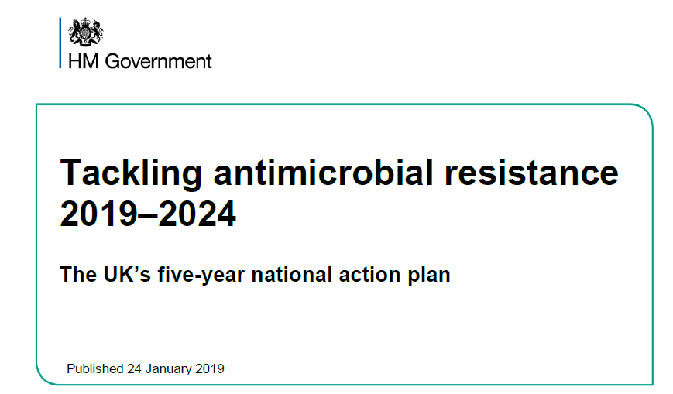
Optimising duration of antimicrobial use in primary care
Notes:
https://www.gov.uk/government/publications/uk-5-year-action-plan-for-antimicrobial-resistance-2019-to-2024

Slide 4
Optimising antimicrobial duration NHS England National medicines optimisation opportunities 2023/24
This guidance describes the 16 national medicines optimisation opportunities for the NHS in 2023/24, and signposts to resources to help with their implementation. We recommend integrated care boards (ICBs) choose at least five medicines optimisation opportunities to focus and deliver on alongside their local medicine optimisation priorities. Progress against chosen opportunities will be reviewed using available data
https://www.england.nhs.uk/long-read/national-medicines-optimisation-opportunities-2023-24/
NHSBSA ePACT2 ICB performance dashboard published here
https://www.nhsbsa.nhs.uk/access-our-data-products/epact2/dashboards-and-specifications/national-medicines-optimisation-opportunities
14. Reducing course length of antimicrobial prescribing
Primary care prescribing data suggests that the shortest effective courses of antibiotics are not consistently prescribed and across general practice there is considerable variation in the proportion of short and long course prescriptions. Within this there may be health inequality in patient exposure to the harms of antibiotics and the threat of antimicrobial resistance
NICE guidance for common infections routinely recommends the shortest effective course of treatment, to reduce selection pressure for antimicrobial resistance and inadvertent patient harm from antibiotic treatment. Five-day courses are recommended when antibiotics are indicated for sinusitis, sore throat, COPD infective exacerbation, cough (acute), pneumonia (community-acquired) and otitis media
What success looks like
By March 2024, 75% or more of total amoxicillin prescriptions as 5-day courses
Notes:
https://www.england.nhs.uk/long-read/national-medicines-optimisation-opportunities-2023-24/
https://www.nhsbsa.nhs.uk/access-our-data-products/epact2/dashboards-and-specifications/national-medicines-optimisation-opportunities

Slide 5
Optimising antimicrobial duration
NICE Antimicrobial Prescribing Guidance reccomendation | AMOXICILLIN 500MG CAPSULES
WHO DDD | 1500MG
Pneumonia (community-acquired): antimicrobial prescribing NG138 | 500MG three times a day for 5 days (higher doses can be used see BNF) 5Y+
Otitis media (acute): antimicrobial prescribing NG91 | 500MG three times a day for 5 days to 7 days Young people under 18Y
Cough (acute): antimicrobial prescribing NG120 | 500MG three times a day for 5 days 5Y+
Bronchiectasis (non-cystic fibrosis), acute exacerbation: antimicrobial prescribing NG117 | 500MG three times a day for 7 days to 14 days 5Y+
Chronic obstructive pulmonary disease (acute exacerbation): antimicrobial prescribing NG114 | 500MG three times a day for 5 days 18Y+
Urinary tract infection (catheter-associated): antimicrobial prescribing NG113 | 500MG three times a day for 7 days only if culture results available and suspectible non-pregnant women and men
Urinary tract infection (lower): antimicrobial prescribing NG109 | 500MG three times a day for 7 days only if culture results available and suspectible pregnant women
Urinary tract infection (recurrent): antimicrobial prescribing NG112 | 500MG single dose or 250MG at night 16Y+ 250MG at night 5Y+
DURATION METRIC ADOPTED | AMOXICILLIN 500MG CAPSULES WHO DDD 1500MG 5 DAY QUANTITY=15 7 DAY QUANTITY=21
Metric development is based on
High volume antibiotic
amoxicillin
NICE guidance dose and duration
500mg oral TDS 5 days
AMR programme priority workstream
linked to E.coli resistance
Define SMART metrics
AMOXICILLIN 500MG CAPSULE
5 DAY = quantity 15
7 DAY = quantity 21
Uses routinely reported data sets
ePACT2 data
Notes:
https://www.nice.org.uk/guidance/health-protection/communicable-diseases/antimicrobial-stewardship

Slide 6
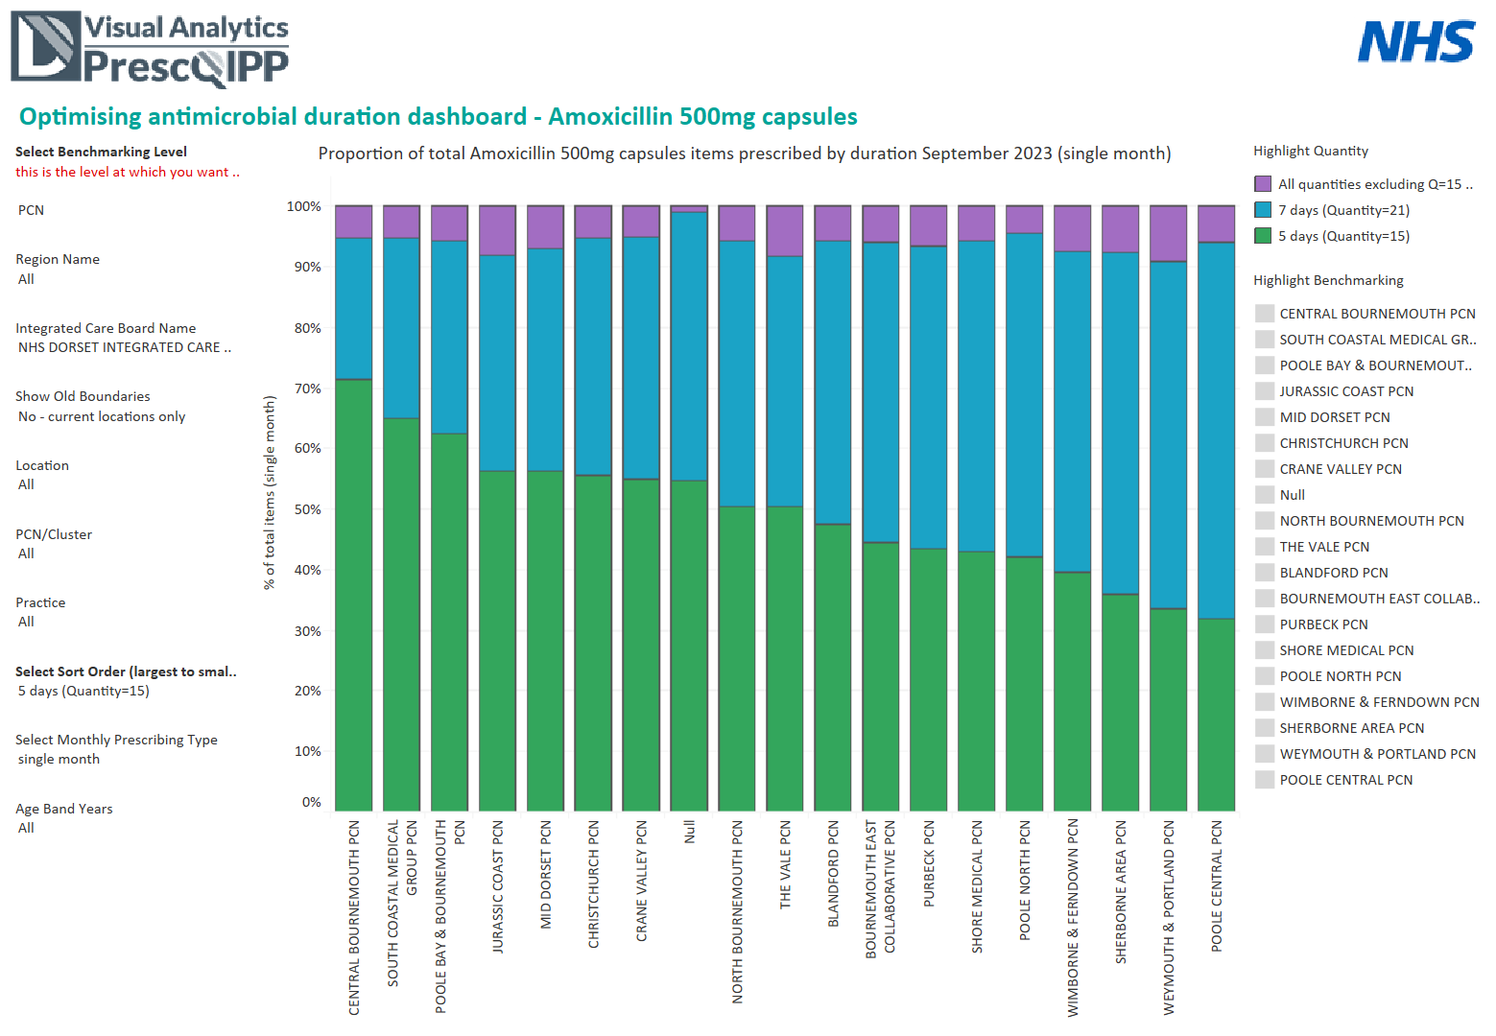
PrescQIPP Optimising antimicrobial duration dashboard - AMOXICILLIN PCN view
Notes:
https://www.prescqipp.info/our-resources/webkits/antimicrobial-stewardship/optimising-antimicrobial-duration-dashboard-amoxicillin-500mg-capsules/

Slide 7
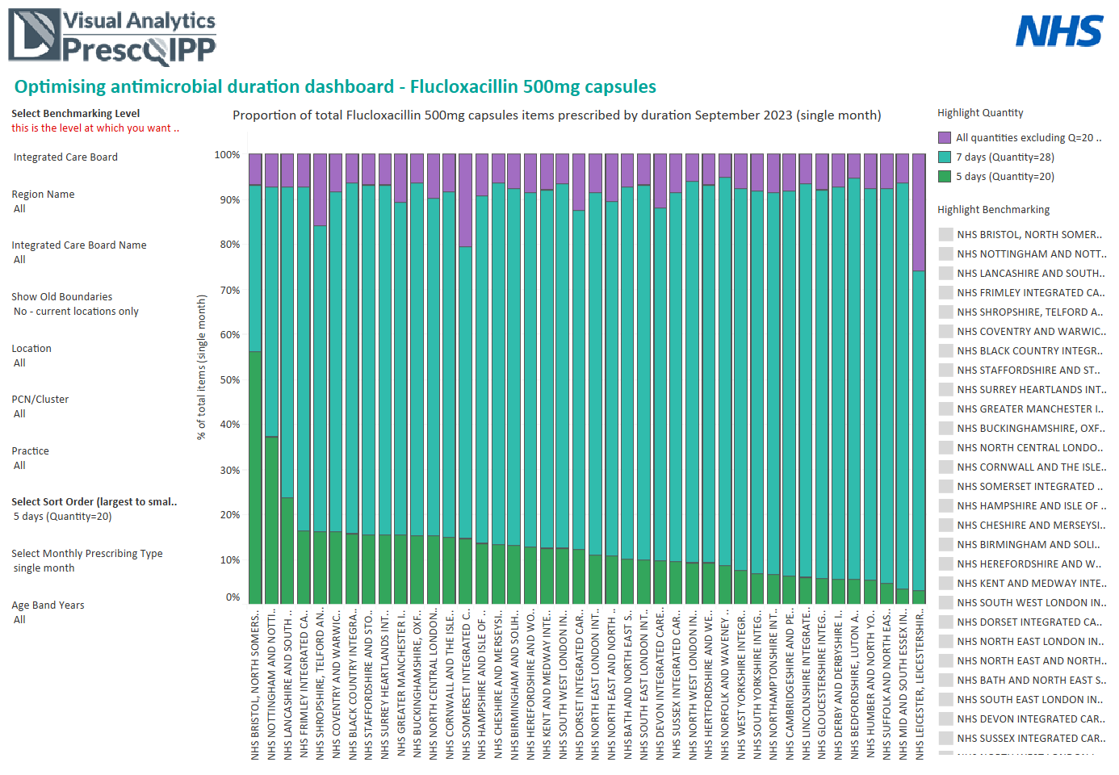
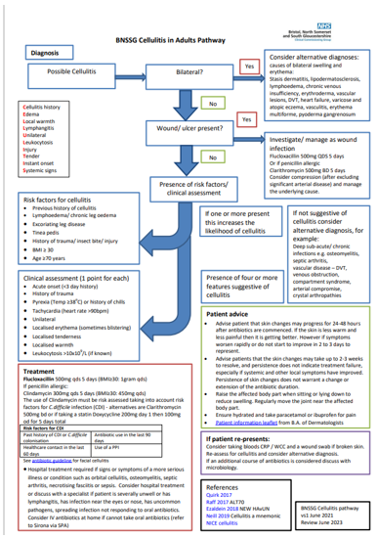
PrescQIPP Optimising antimicrobial duration dashboard - FLUCLOXACILLIN
Notes:
Optimising antimicrobial duration dashboard - Flucloxacillin 500mg capsules | PrescQIPP C.I.C

Slide 8
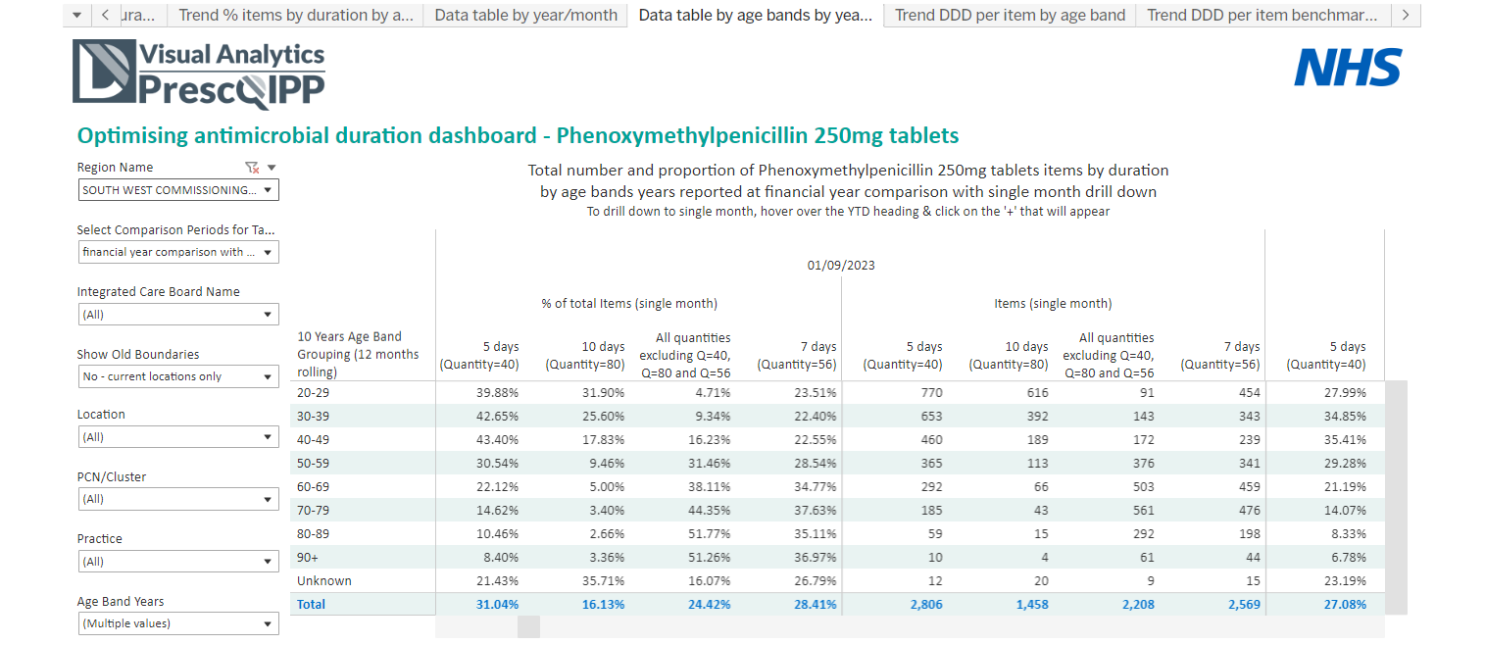
PrescQIPP Optimising antimicrobial duration dashboard - PHENOXYMETHYLPENICILLIN
Notes:
Optimising antimicrobial duration dashboard - Phenoxymethylpenicillin 250mg tablets | PrescQIPP C.I.C

Slide 9
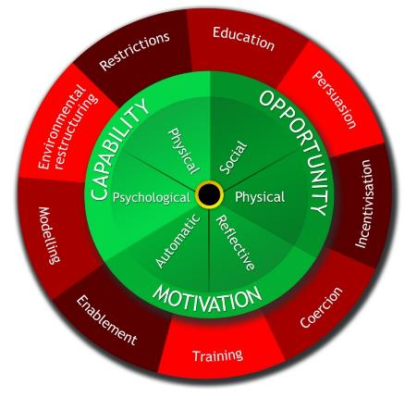
Optimising antimicrobial duration
Use rules to reduce the opportunity to engage in the behaviour (or to increase behaviour by reducing opportunity to engage in competing behaviours)
Set prescribing system to default to 5 day duration – Opt Out approach
Increase knowledge or understanding
Implement into guidelines with education. Use the national Duration resources.
Robust evidence base as metrics set on NICE guidance content
Shared learning via PrescQIPP AMS VPG WAAW 2023 webinar
The BCW:
Nudge/ Change the physical or social context
Clinical decision support alerts
Position EMIS/SystmOne antibiotic pick list at 5 day duration quantity
Choose 5-day original packs
Use a SystmOne antimicrobial formulary
Integrate into infection pathway guidance
Use communication to induce positive or negative feelings to stimulate action
WAAW2022 Shorter is Better Brad Spellberg webinar
Include in local bulletins
Use local expert opinion to endorse
Behavioural theory at its core
9 Intervention Functions:
‘broad categories of means by which an intervention can change behaviour’
Create an expectation of reward
NHS England Medicines Optimisation Opportunity
Local prescribing Incentive scheme
Provide an example for people to aspire to or emulate
Use PrescQIPP Optimising antimicrobial duration data for benchmarking
Use local opinion leaders to endorse and champion
Increase means or reduce
barriers to increase capability (beyond education
or training) or opportunity (beyond environmental
restructuring)
Make guidelines accessible and easy to use
Easy access to Duration infographics
Position EMIS/SystmOne antibiotic pick list at 5 day duration quantity
Use clinical decision support software and/or templates
Make 5 day original packs easily available
Create an expectation of punishment or cost
Harm to patient and family and carers
Potential litigation
Impact of local drug-bug resistance rates
Reputational harm
Impart skills
Practice prescribing visits
Expert webinars

Slide 10
ANTIBIOTIC DURATIONS FOR COMMON INFECTIONS IN PRIMARY CARE (ADULTS)
NICE recommended durations of antibiotic courses for first-line treatments
Cellulitis and Erysipelas
Acute otitis media with risk of complication or systemically unwell
Pyelonephritis (acute) men and non-pregnant women
UTI (lower) non – pregnant women
5
0
3
5-7
7
7-10
10
Days
Acute sinusitis
COPD acute exacerbation
Acute cough with risk of complications or systemically unwell
Community Acquired Pneumonia (CAP)
Sore throat according to FeverPAIN/CENTOR score for symptomatic cure only
Sinusitis symptoms less than 10 days
Acute cough no risk of complications
Viral sore throat according to FeverPAIN/CENTOR score
Asymptomatic bacteriuria
Acute otitis media
UTI (lower) men and pregnant women
Catheter-associated UTI (CAUTI)
Sore throat -according to FeverPAIN/CENTOR score 10 days for Penicillin V ONLY for microbiological cure
NICE RECOMMENDED FIRST LINE ANTIBIOTIC TREATMENT (CHECKED APRIL 2023)
Notes:
summary-antimicrobial-prescribing-guidance_Dec-22_final.pdf (bnf.org)

Slide 11
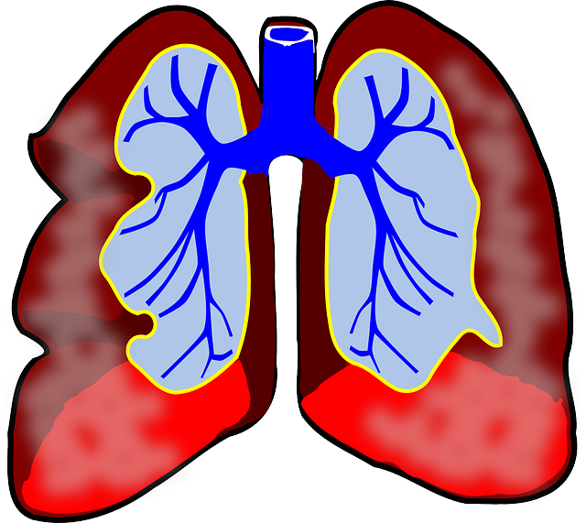
5 DAYS FOR 5 INFECTIONS (ADULTS)
COPD (acute infective exacerbation) Amoxicillin 500mg three times a day for 5 days OR doxycycline 200mg day 1 and then 100mg daily on days 2-5 OR clarithromycin 500mg twice a day for 5 days
Acute Cough (if antibiotic indicated) Doxycycline 200mg day 1 then 100mg daily on days 2-5 OR amoxicillin 500mg three times a day for 5 days OR clarithromycin 250mg to 500mg twice a day for 5 days OR erythromycin 250mg to 500mg four times a day or 500mg to 1g twice a day for 5 days
Acute Sinusitis (if antibiotic indicated) Phenoxymethylpenicillin 500mg four times a day for 5 days OR if systemically very unwell co-amoxiclav 500/125mg 1 three times a day for 5 days OR for penicillin allergy doxycycline 200mg on day 1, then 100mg daily on days 2-5 OR clarithromycin 500mg twice a day for 5 days OR erythromycin (in pregnancy) 500mg four times a day for 5 days
Community Acquired Pneumonia Amoxicillin 500mg to 1g three times a day for 5 days OR doxycycline 200mg on day 1, then 100mg daily on days 2-5 OR clarithromycin 500mg twice a day for 5 days OR erythromycin (in pregnancy) 500mg four times a day for 5 days
Sore Throat (if antibiotic indicated) Phenoxymethylpenicillin 500mg four times a day for 5 days for symptomatic cure OR clarithromycin 250mg to 500mg twice a day for 5 days OR erythromycin 250mg to 500mg four times a day for 5 days
5
NICE RECOMMENDED FIRST LINE ANTIBIOTIC TREATMENT (CHECKED APRIL 2023)
Notes:
summary-antimicrobial-prescribing-guidance_Dec-22_final.pdf (bnf.org)

Slide 12
Development of the acne and COPD “How to” resources
Time constraints of consultations in practice makes it difficult to provide a targeted review
Need for structured approach to medication review with relevant treatment guidelines, patient facing material, self-care and digital apps
Role play of ‘typical consultation’ with production of the resource
Sent to stakeholders from all regions including antimicrobial leads and comments included in final versions
November 2023
rcgp.org.uk/TARGETantibiotics
12
Notes:
Presenter talk
The aim was to develop a resource for reviewing patients on long term and frequent use of antibiotics.
Time constraints of consultations in practice makes it difficult to provide targeted reviews. The ‘How to’ resources were developed with aim of up-skilling other members of the practice team to undertake effective reviews that will improve patient care and reduce GP appointments for acne and COPD.
It is important to have resources to support teams with consultations to manage patient expectations and develop health literacy.
Stakeholder feedback during the development of the resource was received from 21 respondents. Resources were originally aimed at GP based practice pharmacists and evolved as feedback would be relevant across the primary care team. The final resources include treatment options, self care, digital apps, visual. for structured approach
There are currently two ‘How to…’ booklets, one on acnes and one on COPD. Available at: https://elearning.rcgp.org.uk/mod/book/view.php?id=12649

Slide 13
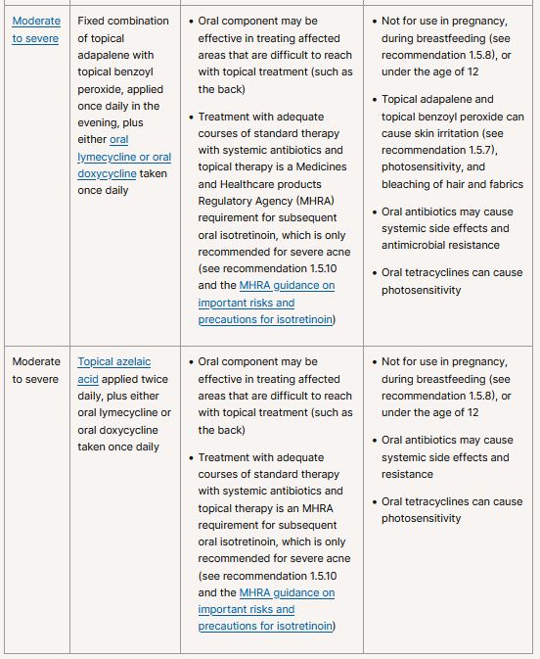
Optimising antimicrobial duration - ACNE
Notes:
https://www.nice.org.uk/guidance/ng198

Slide 14
Why should you review patients on repeat and long term antibiotics for acne?
1
Research has highlighted growing concerns of antibiotic resistance in treatment of acne and prescribing patterns suggest an overuse of antibiotics in patients
2
44.5% of people with a new acne diagnosis received a prescription for long-term antibiotics
3
Conversations with patients about withdrawing acne antibiotic treatment have been deemed difficult and sensitive
November 2023
rcgp.org.uk/TARGETantibiotics
14
Notes:
Presenter talk
We know that acne is a common skin condition, and that treatment is determined by the severity of the acne and how much it affects the individual. There are growing concerns about antibiotic resistance in the treatment of acne (1,2). Doxycycline and lymecycline are the NICE guidance first line oral antibiotics (both tetracyclines).
Studies looking at prescribing patterns have found that the most common prescription given at the initial acne consultation was an oral antibiotic alone, (against NICE guidance), closely followed by topical antibiotics (3).
National data reveals that acne is one of the most common indication for long-term and/or repeated antibiotic use and a study in 2022 showed that 44.5% of people with a new acne diagnosis received a prescription for long-term antibiotics (4).
Stepping down antibiotics requires a structured review and assessment. Conversations with patients about withdrawing acne antibiotic treatment have been deemed difficult and sensitive (5), stepping down antibiotics needs a targeted review and the How to… booklet helps with those conversations
There are also risks of inadequate management include;
acne scarring
Mental health distress
hyperpigmentation
access of online treatments from unregulated providers
Slide references
Walsh TR, Efthimiou J, Dréno B (2016) Systematic review of antibiotic resistance in acne: an increasing topical and oral threat. Lancet Infect Dis 16, 3, e23–e33.CrossRefGoogle Scholar
Santer M, Francis NA, Platt D, et al.(2018) Stemming the tide of antimicrobial resistance: implications for management of acne vulgaris. Br J Gen Pract 68, 667, 64–65.FREE Full TextGoogle Scholar
Francis NA, Entwistle K, Santer M, et al.(2017) The management of acne vulgaris in primary care: a cohort study of consulting and prescribing patterns using the Clinical Practice Research Datalink. Br J Dermatol 176, 1, 107–115.Google Scholar
Bhate K, Mansfield KE, Sinnott S-J, Margolis DJ, Adesanya E, Francis N et al. Long-term oral antibiotic use in people with acne vulgaris in UK primary care: a drug utilisation study. British Journal of Dermatology. 2022;188(3):361-71
Platt D, Muller I, Sufraz A, Little P, Santer M. GPs' perspectives on acne management in primary care: a qualitative interview study. Br J Gen Pract. 2020 Dec 28;71(702):e78-e84. doi: 10.3399/bjgp20X713873. PMID: 33257464; PMCID: PMC7716869.

Slide 15
Patient centred review
 | Item to consider
Condition and consultation history | Establish history of patients' condition
 | Patient baseline habits
 | Are they under a specialist consultant
Treatment History | Treatment/Prescription history
 | Side effects to treatment
 | Compliance to treatment
 | Patient’s perception of their treatment
Patient Impact and preference | Explore impact acne has had on self-esteem or mental health
 | What are the patient's preferences and expectations from treatment?
November 2023
rcgp.org.uk/TARGETantibiotics
15
Notes:
Presenter talk
We developed the worked examples using the principles from the How-to toolkit in using a structured step wise approach
After conducting a search on the clinical system for patients with recurrent antibiotic courses for lymecycline and doxycycline and/or coded for acne, we look to carrying out a patient centred review and this table covers the points in the review
Establish a clear history of the patient’s condition, current use of medication and baseline habits alongside lifestyle modifications and treatments tried to-date.
Investigate if any medication may have exacerbated acne (see section 2.2)
➢ Explore any impact their condition has on their self-esteem and mental health. To note: This may need special consideration and appropriate referral (see Section 3.3.3). ➢ Listen to the patient’s concerns and priorities and establish their expectations for management of their condition.
Be aware of any special considerations, e.g.: o Darker skin tones: ▪ Acne is no more common or severe in pigmented skin. ▪ Post-inflammatory hyperpigmentation can be more marked, therefore, treat patients with darker skin tones early and more aggressively, including earlier consideration of referral to secondary care or a dermatology service (PCDS, 2022). o Women of childbearing potential: ▪ ‘Topical retinoids and oral tetracyclines are contraindicated during pregnancy and when planning a pregnancy’, women must use effective contraception or choose alternative treatment to these options (NICE b, 2021). ▪ ‘If a person receiving treatment for acne wishes to use hormonal contraception, consider using the combined oral contraceptive pill in preference to the progestogen-only pill’ (NICE b, 2021).

Slide 16
COPD
How to review resource and
prevention of exacerbation toolkit
Presented by: Naomi Fleming
Notes:
Standard title slide

Slide 17
Why review patients with COPD that use antibiotics frequently?
COPD is an important chronic disease which often disproportionately impacts the more deprived members of our population
Approx 1.3 million diagnosed, >30,000 deaths/year
It carries significant detrimental impact on quality of life and function for patients
Individual and societal costs – health, social, psychological, economic
Character + chronicity of this respiratory disease means significant reliance on urgent, primary and secondary care services – including over-exposure to antibiotics and steroids
More can and should be done to focus on secondary prevention

Slide 18
How to review TARGET resource

Slide 19
Review of Antibiotic Use
For patients with rescue packs
Review previous exacerbation and antibiotic use history.
Advise to respond promptly to exacerbation symptoms by following their action plan
1) adjust short-acting bronchodilator therapy,
2) take steroid rescue pack if breathlessness interferes with activities of daily living,
3) only add antibiotic rescue pack if sputum colour changes or increases in volume or thickness compared to normal day to-day variation, and
4) tell their healthcare professional
Adverse effects of antibiotic treatment
Importance of seeking medical help if symptoms deteriorate rapidly/significantly.
Consider removing rescue packs from the repeat medication list and adding as acute issues to prompt clinical review
For patients on antibiotic prophylaxis:
Ensure self-care measures are followed and inhaler therapy is optimised.
Review long-term macrolide after the first 3 months of treatment initiation and every 6 months thereafter Only continue treatment if a meaningful reduction in frequency of exacerbations or improvement in quality of life outweigh risks of treatment
Prophylactic antibiotics should be ‘restricted to those individuals where they are safe and likely to be effective, and to avoid the risk of widespread overuse that could raise AMS concerns.
NICE committee recommended restricting the use of prophylactic antibiotics to ex-smokers and non-smokers.
For acute exacerbations, continuous antibiotic prophylaxis treatment can continue with the addition of an acute course of antibiotic treatment belonging to a different therapeutic class

Slide 20
Why develop the COPD-Prevention of exacerbation Toolkit (PET)?
To be used alongside the COPD ‘How to’ guide, a checklist document for primary care teams:
To work through with patients during consultation
Act as a memory aid of steps that should be considered
November 2023
rcgp.org.uk/TARGETantibiotics
20
Notes:
Presenter Talk
Future work highlighted as part of the ‘How to…’ resource was to develop a checklist for primary care teams to use during the consultation and to pilot it in GP practice. This checklist could be used in conjunction with the how to guide to act as an aide memoire of steps that should be considered to avoid or reduce the risk of infection and alternatives to antibiotics before prescribing rescue packs or continuing long-term antibiotic prophylaxis.
A COPD Prevention of Exacerbation Toolkit (COPD-PET) has been developed to support the review of patients prescribed long term, or repeated courses, of antibiotics. The COPD-PET is not yet published but us currently being piloted within GP practices and a respiratory hub in the East of England. The pilot will evaluate patient outcomes, patient and staff satisfaction, and support consideration of adoption and spread in other regions if successful.

Slide 21
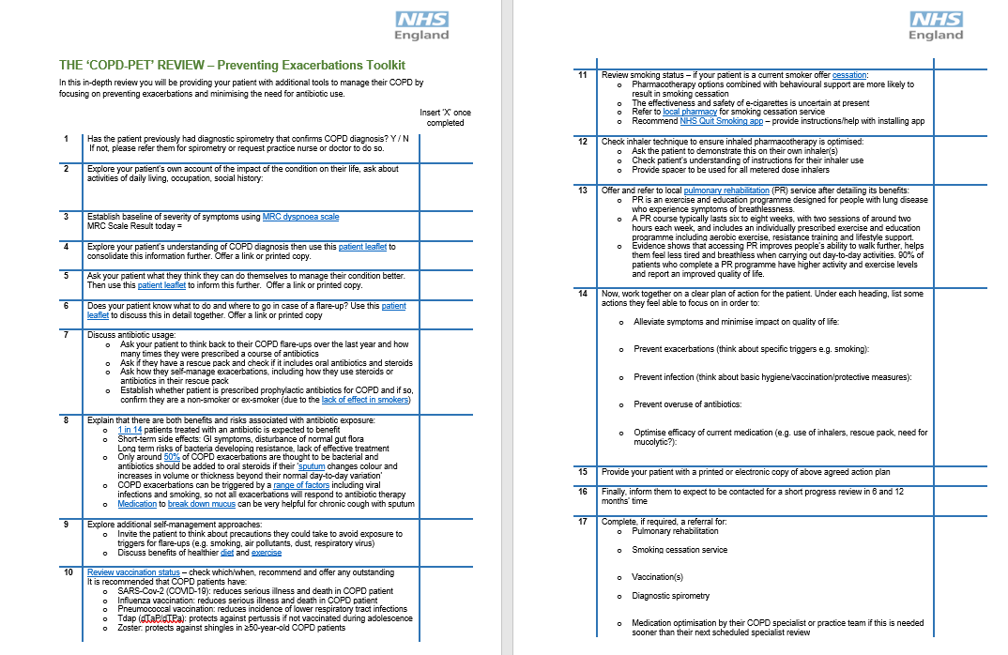
COPD-PET checklist

Slide 22
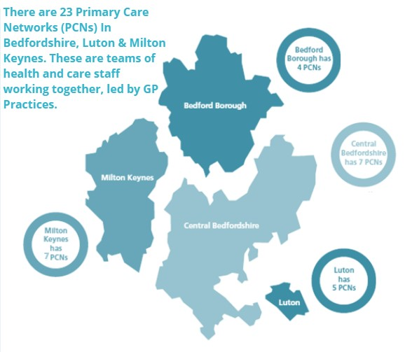
Pilot site – eQuality Primary Care Network (PCN) in Luton part of the Bedfordshire, Luton and Milton Keynes ICS in East of England
The aim of the pilot is to explore the impact of the toolkit on preventing infective exacerbations and reducing antibiotic use for COPD patients at high risk of recurrent infections. The project is a collaboration between NHS England, eQuality PCN and the MLCSU.
1 of 5 PCNs in Luton
Luton
A diverse, densely populated town with over 150 languages and dialects spoken. It has a younger than average population and above average levels of unemployment and deprivation, with high levels of child poverty.
A multidisciplinary clinical team including GPs, nurses, pharmacists, pharmacy technicians and social prescibers
Serves a patient population of approximately 40,000

Slide 23
Patient Survey responses – When asked for feedback and comments post COPD-PET review
“Staff were very professional, knowledgeable and friendly. Made you feel at ease. First time I have been informed fully of COPD and of how to help manage it. I fully recommend this service.”
“This was the best review I've had full of information and ideas excellent would like to see more of this sort of thing.”
“I felt the review was totally about me and any needs I may have. Also, I can make notes of any minor thoughts I may have between now and my next review. Very pleasant and professional approach in all aspects. Thank you.”
“Very helpful thank you - best knowledge I have received about COPD.”
“Very friendly made me feel comfortable explained very well.”
“Please keep this in regularly especially during winter.”

Slide 24
Next steps for COPD resources
Pilot results will be shared with key teams and inform policy initiatives
Once pilot complete, the COPD-PET will be published in the TARGET toolkit
Further resources to support staff training on COPD will be developed:
A slide set with patient worked examples
A consultation video
If your practice is interested in piloting the COPD-PET please contact:
Dr Naomi Fleming: naomifleming@nhs.net
Are you interested in joining a community of practice for antimicrobial stewardship?
Please contact england.amrprescribingworkstream@nhs.net with email address & job role
November 2023
rcgp.org.uk/TARGETantibiotics
24
Notes:
Presenter talk
Next stages for the clinical team are to do a 6 month and 12 month follow up.
Results will be shared with key team members and inform policy.
Access to COPD PET - it is still in pilot phase and amendments may be made. Once pilot is complete it will be published on TARGET alongside the How To COPD resources
Roughly 6 months left on pilot and then will be available on the toolkit.
If your practice would like to pilot the COPD PET checklist or would like a copy please contact Naomi

