Slide 1
Practice Plus Webinar 29th November 2023
Steve Williams
Lead Clinical Pharmacist PrescQIPP Practice Plus

Slide 2
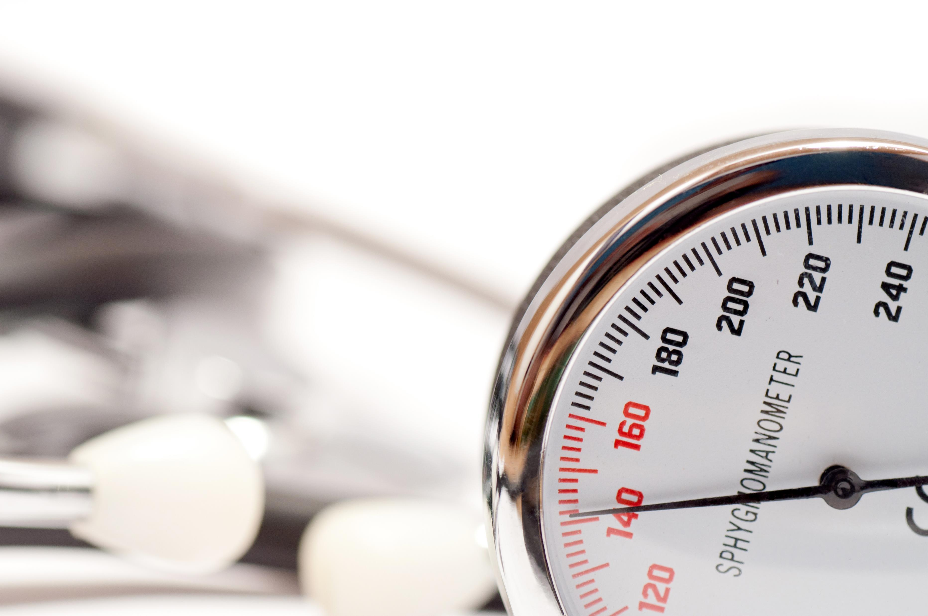
Nottingham West PCN Pharmacy Cardiology Team:
Improving Hypertension case finding, diagnosis and treatment
Notes:
Beth
12 surgeries and 109K patients
This is focused on phase 1
On the back of winning a PRESQIPP award

Slide 3
The Solution – A Pharmacy Lead Hypertension Case finding Service
At scale initiative
Using pharmacists as clinicians in their own right
Screen, diagnose and manage
Notes:
Beth
Work at scale across all 12 practices
Working in partnership with CP
What we did was to trust our pharmacists to be clinicians in their own right and empowered our pharmacy technician to fulfil their clinical potential within a pharmacy lead hypertension case finding service
Our solution enabled us to screen, diagnose and manage patients on behalf of our practices, being part of the solution to current capacity issues within general practice

Slide 4
System Searches
Screen Patient
Information letter
ABPM/HBPM
Diagnosis
Tests
Lifestyle / Prescription
Follow up
The Patient
GP Team
Community Pharmacy
Notes:
Mo
So what actually happened on a day to day basis:
We set up system one searches to identify patients with a raised clinic BP that had had no follow up.
We screen the patients for suitability, some were already under the care of the practice, or may not currently be suitable for contact – e.g. 2ww
The patients were then sent a text with a letter explaining about raised BP and the fact we want to get in touch with them.
We then follow up and phone the patients to talk through ABPM vs HBPM and refer to the CP when appropriate
On receipt of results we will inform the patient if normotensive and give lifestyle advice, or make a diagnosis, explaining this to the patient
Order appropriate tests – bloods, urine and ecg
Go on to prescribe when appropriate and offer lifestyle advice, following the patient up and titrating meds appropriately until BP under control.

Slide 5
9,000+ patients initially identified
3,250 patients reviewed.
81% of patients were suitable to be offered the pilot,
49% opted in
312 Newly diagnosed patients
3203 GP appointments freed up
25% hypertension diagnosis rate
This Photo by Unknown Author is licensed under CC BY-SA
Notes:
Beth
What did Nottingham West achieve in the first year?
We achieved a 25% hypertension diagnosis rate
312 patients diagnosed with hypertension by our clinical pharmacy team.
We freed up 3203 GP appointments
Using UCL partners predictions for hypertension across a population we estimate that this work in NW will Prevent 1.9 heart attacks and 2.8 strokes over the next 3 years

Slide 6
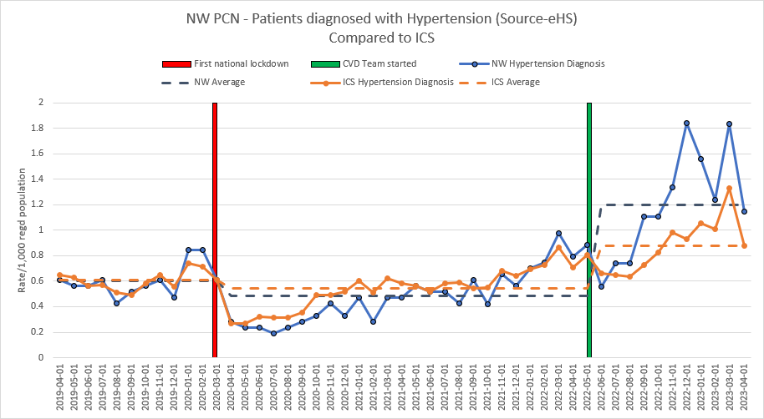
Notes:
Beth
And we have dramatically increased prevalence, as shown by the blue line on this graph, in comparison to the orange line, which is the ICS prevalence as a whole.
The dotted lines are the average.
Average diagnosis numbers per month have soared from 50 patients to 130 patients per month

Slide 7
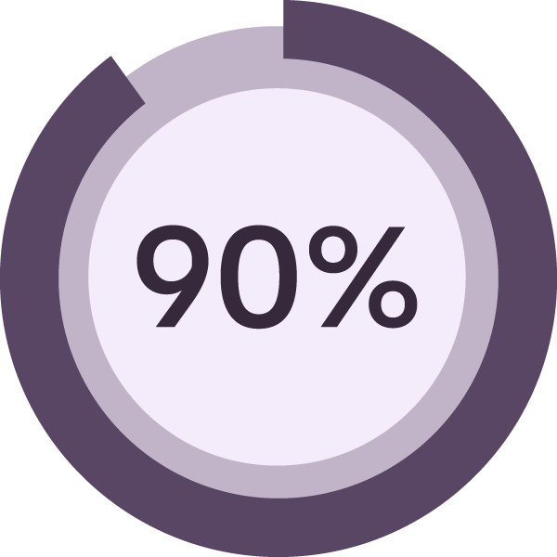
Patient engagement
Of patients would recommend this service to others
88% rated their experience as Excellent, very good
15% didn’t know that raised BP increases risk of CVD
68% made some lifestyle changes another 35% say they PLAN to make changes
5 people stopped smoking
27% of respondents were diagnosed with hypertension
88% stated the team made them feel at ease
70% felt the team helped them take control of their health
Notes:
Beth
And our patient loved it too….
And as you can see by the many other indicators on this slide, this service is really valued by our patients

Slide 8
Antidepressants Deprescribing pilot clinic (2022) Raz Saleem Pharmacist – Mental Health Prescribing Lead Medicines Management Team (MMT)

Slide 9
Why? rates & ppg
Number of unique patients prescribed antidepressants (per 1,000 patients)
NHS SOUTH YORKSHIRE ICB - 03L highlighted within results for all SICBLs during Dec-22
Numerator Definition
Number of unique patients prescribed an item from Antidepressant Drugs (0403)
Denominator Definition
Practice list size
Methodology
(Numerator / Denominator) * 1,000
Source: ePACT2
Rotherham

Slide 10
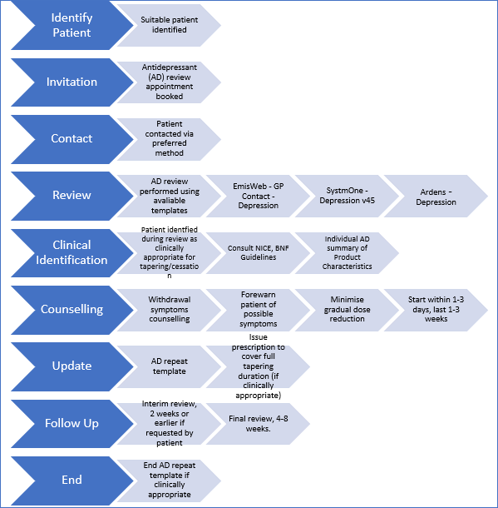
Pilot summary

Slide 11
Invites
8446 - on antidepressants for > 2 years (without history of repeat depressive episodes or relapse)
7451 invited (88%, 7451/8446)12% = no mobile number for SMS or coded as explicitly dissented to receive SMS
6598 (89%) clicked SMS link through to patient service info leaflet
692 self-referred to service (of which 657 eligible to be reviewed)

Slide 12
Results
252 pts reduced antidepressant dose (38%)
405 stopped antidepressant (62%)
# referred to IAPT or Social Prescriber = unobtainable due to majority of patients self-referring upon providing advice
5 (0.7%) patients were unsuccessful (in this attempt) to reduce/stop their antidepressant and returned to their original dose.
3 (0.4%) patients reported withdrawal symptoms (transient) that affected their daily activities

Slide 13
Med Review (the how)
Pre-appointment prep
Ask the Q → set goal
Monthly Contacts/Changes
Let pt set the pace → Any reduction = ☺
Share success

